Slide 1

Embedded Software Programming
Ambuj Varshney
ambujv@nus.edu.sg
Notes:
++ Thank you for inviting me to give this talk
++ In this talk, I will present a pathway that can enable us to make wireless embedded systems ubiquitous. I will describe my previous research efforts that tackle the critical challenges that limit the growth of wireless embedded systems. These are related to the growing energy asymmetry that exists between sensing, computation and communication blocks on these platforms.
++ Finally, I will conclude my talk by covering the research agenda that I would like to work on as a faculty member.

Slide 2
Course Overview, Logistics and
Embedded Systems Basics
Notes:
++ Over the past few years, I have designed several backscatter and beyond backscatter systems that precisely overcome these critical challenges that have limited the widespread deployment of backscatter on IoT devices.
++ The research vision that I have pursued and would like to pursue as a faculty member is to enable a massive deployment of IoT devices by bridging the energy asymmetry between sensing, computation and communication blocks by designing novel platforms and communication mechanisms. I am going to describe some of my research contributions next.

Slide 3
Roadmap of the lecture today
Let us get to know the instructor ☺
What is this course about? Logistics? Grading Criteria?
Introduction to Embedded Systems, Rapid Growth
Mark Weiser Vision for Ubiquitous Computing
Understanding the Device Architecture and Scaling of Embedded Systems
Notes:
Here is the roadmap of the major topics that I am going to cover during the presentation. We have already covered the exponential growth of the internet of things; next, I will talk about the critical energy challenge that can severely hinder this massive growth and preventing us from realising this immense economic value enabled by the IoT.

Slide 4
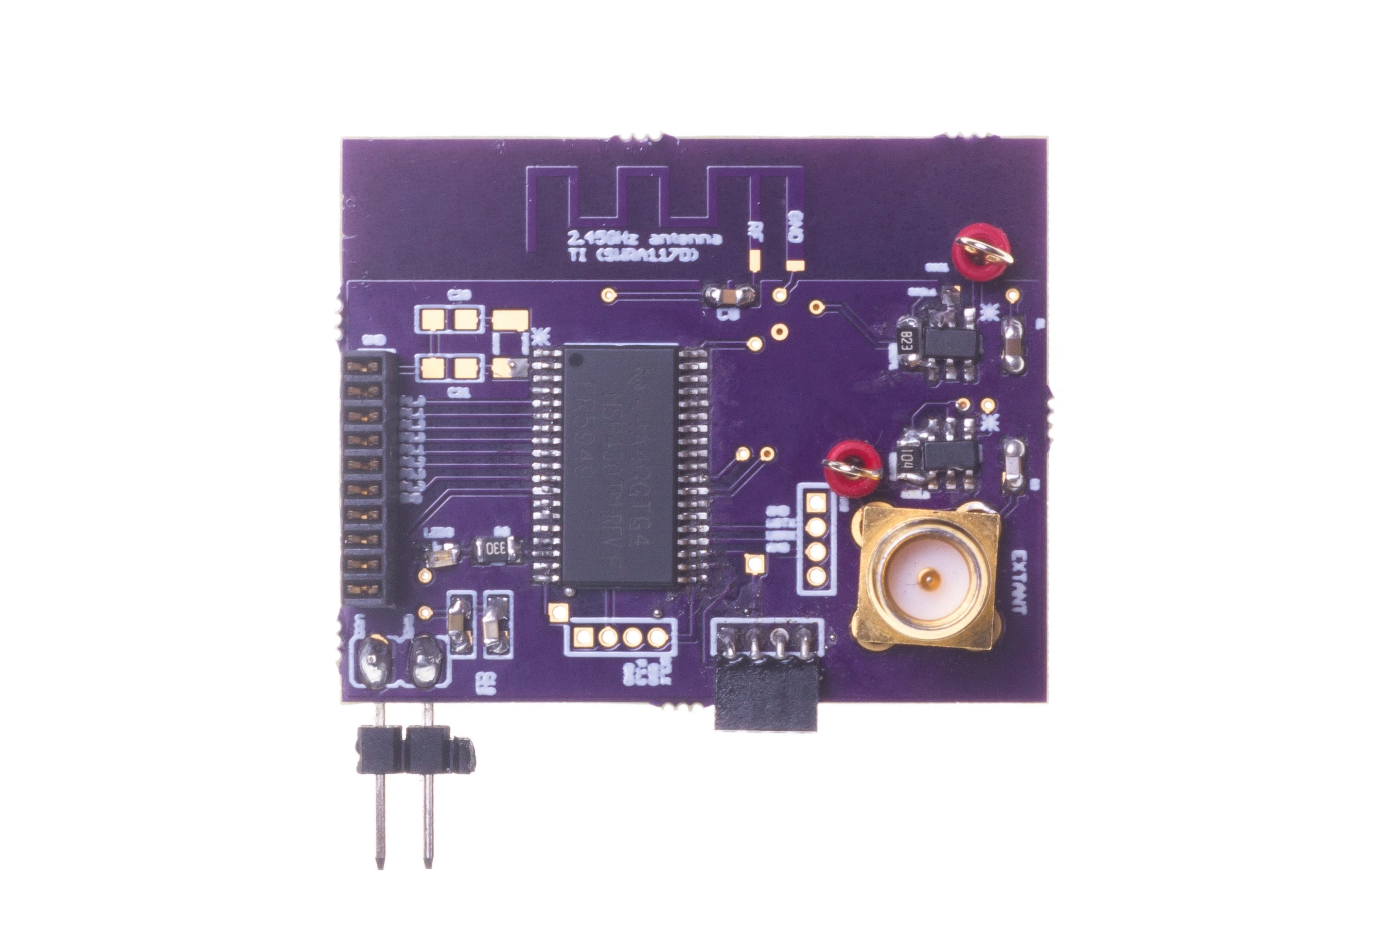
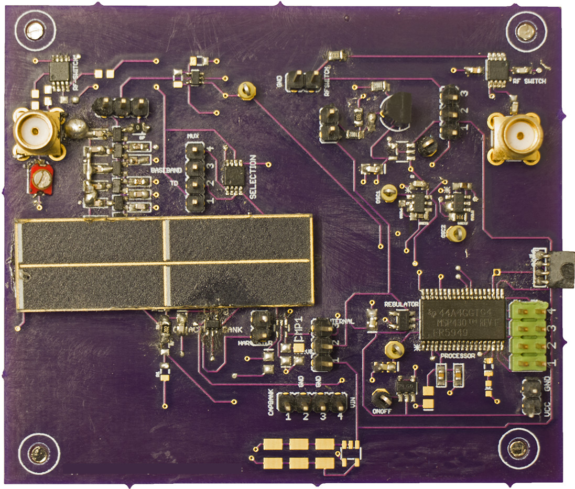
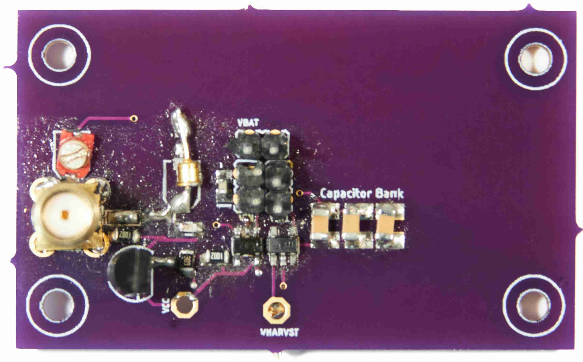
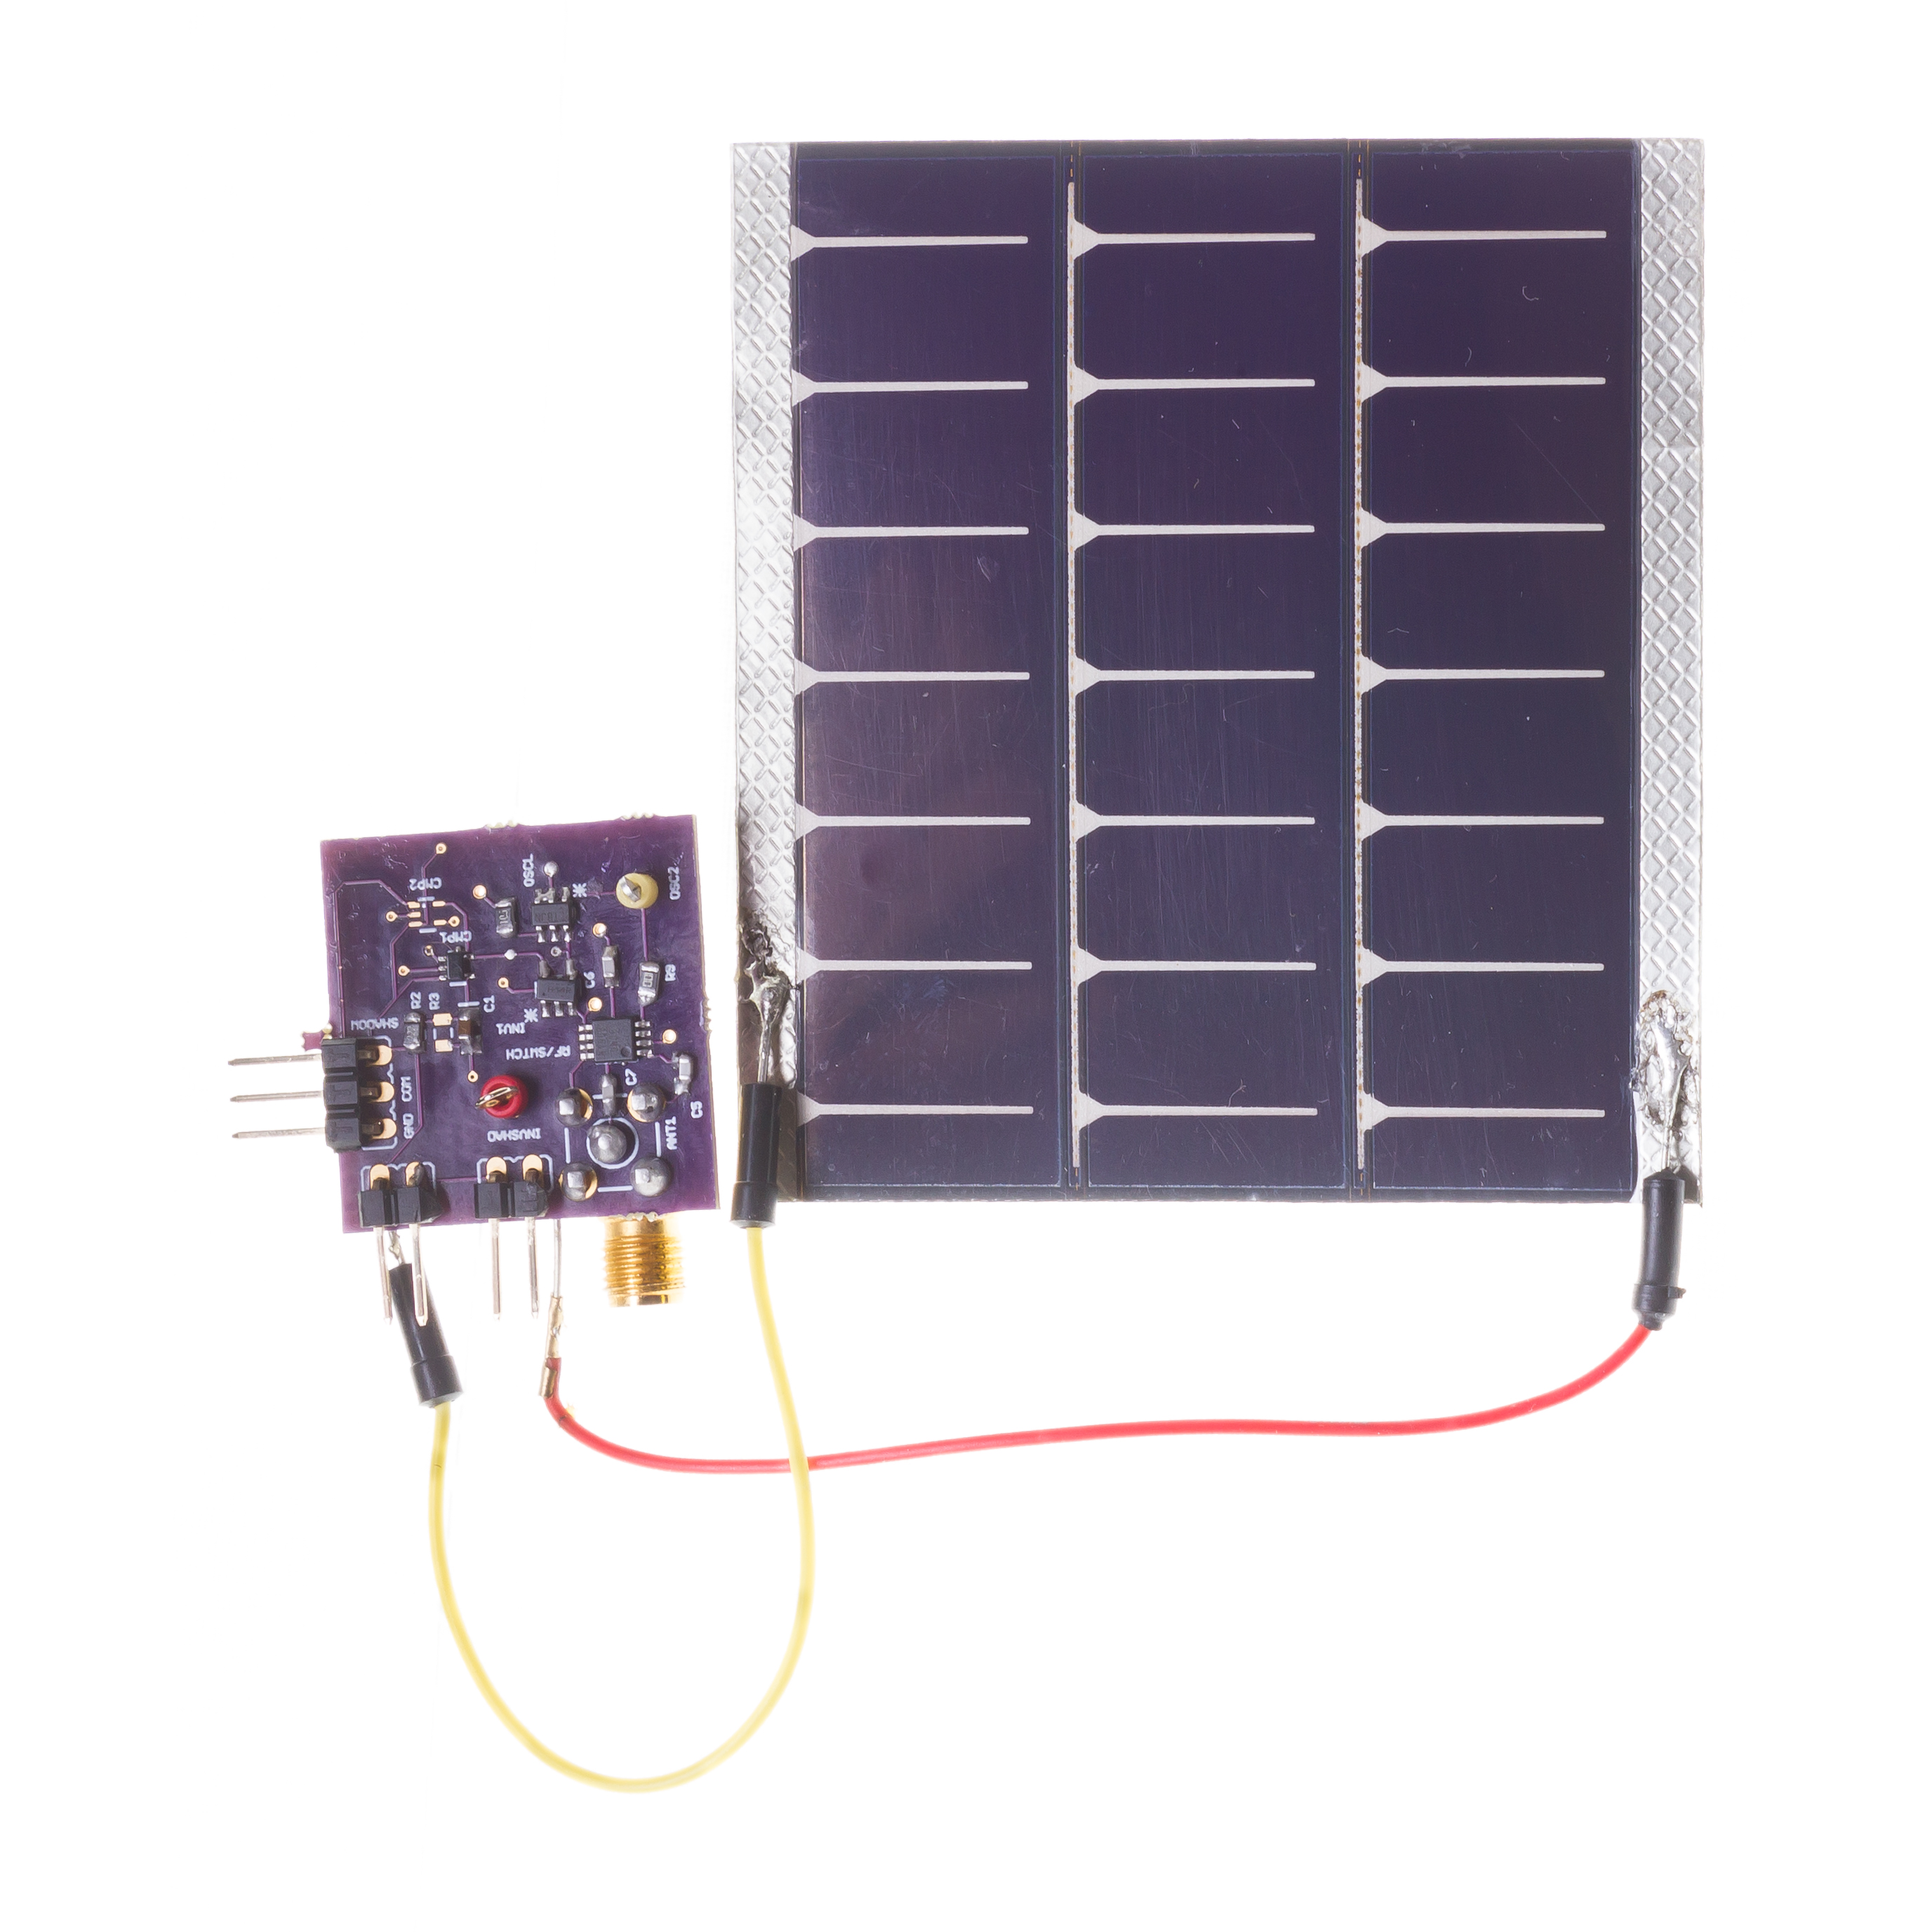
Let us get to know the instructor of the course
Build real embedded and wireless systems. Functional prototypes
Wireless embedded systems: Journey started over 14 years back!
Commonly, our work involves designing systems at the intersection of computer science, electrical engineering and computer communication
[ACM SENSYS 2017]
[ACM MOBISYS 2020]
[ACM MOBICOM 2020]
[ACM VLCS 2017]
Notes:
++ We may all have heard of the term Internet of Things. So how are these wireless embedded systems related to the Internet of Things: Today, IoT includes a broad class of devices, including powerful platforms such as smartphones. However, it also includes more resource-constrained devices and what we call Wireless Embedded Systems, and in fact, I consider it to be one of the essential parts of the IoT ecosystem.
++ These are platforms equipped with a radio transceiver, sensor, microcontroller, and some form of energy storage. These platforms also often form a network, and sensor network as it is called has been an active area of research for the past two decades.
++ The research community has also developed wireless embedded platforms which we may know about, and these include: CMUCAM, which is an image sensor platform developed at Carnegie Mellon University, or Permamote is long life sensor platform from the lab I am associated with at UC Berkeley or Lorea which is a long-range backscatter platform that I had developed as part of my doctoral dissertation at Uppsala University. All of these are an example of Wireless Embedded Systems.

Slide 5
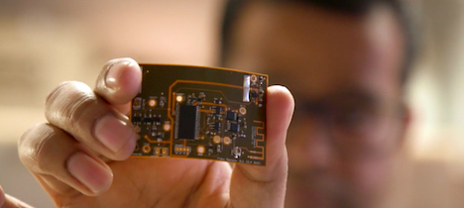


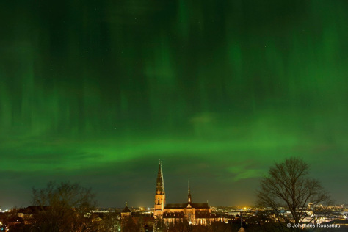

Let us get to know the instructor of the course
Doctoral studies conducted in Sweden. PhD from Uppsala University
Dissertation: Enabling sustainable networked embedded systems
Doctoral dissertation awarded 2019 ABB Research Award (Funded Postdoc)
Postdoctoral studies conducted at UC Berkeley
Make sticker computers! STICORS
Notes:
++ We may all have heard of the term Internet of Things. So how are these wireless embedded systems related to the Internet of Things: Today, IoT includes a broad class of devices, including powerful platforms such as smartphones. However, it also includes more resource-constrained devices and what we call Wireless Embedded Systems, and in fact, I consider it to be one of the essential parts of the IoT ecosystem.
++ These are platforms equipped with a radio transceiver, sensor, microcontroller, and some form of energy storage. These platforms also often form a network, and sensor network as it is called has been an active area of research for the past two decades.
++ The research community has also developed wireless embedded platforms which we may know about, and these include: CMUCAM, which is an image sensor platform developed at Carnegie Mellon University, or Permamote is long life sensor platform from the lab I am associated with at UC Berkeley or Lorea which is a long-range backscatter platform that I had developed as part of my doctoral dissertation at Uppsala University. All of these are an example of Wireless Embedded Systems.

Slide 6
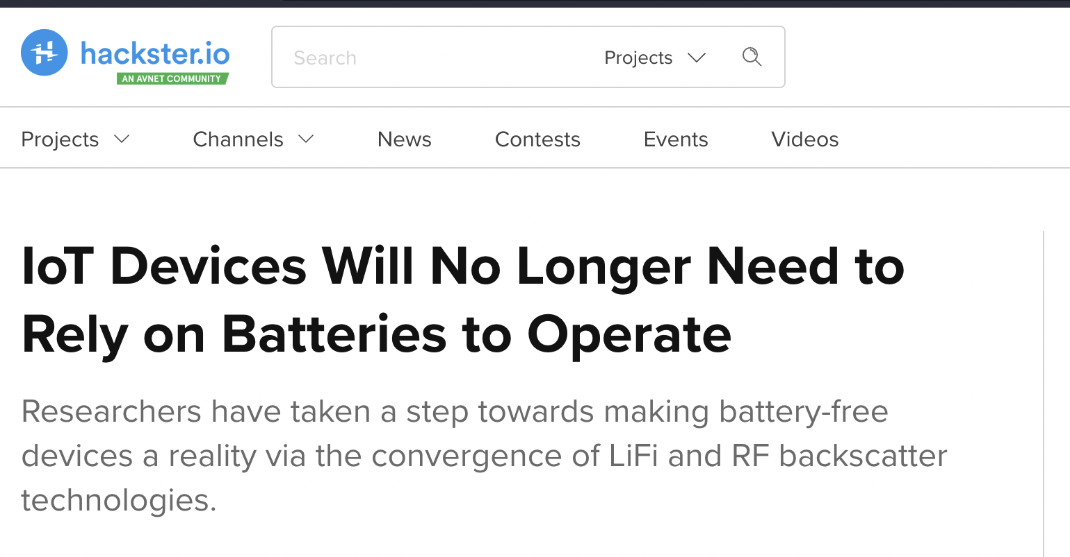

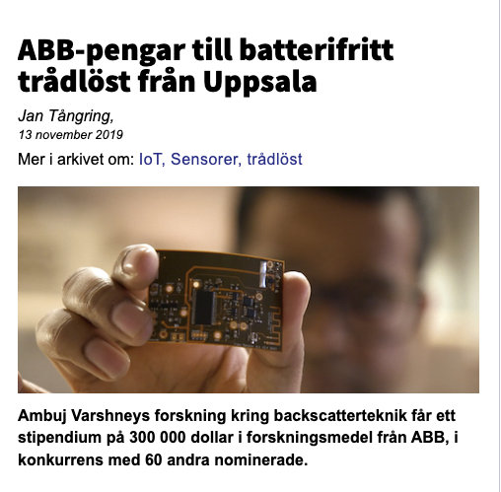
Wireless, Embedded Intelligence, Sensing and Emerging Technologies (WEISER) Group
World leading research in the area of wireless embedded systems
2 PhD students, 1 Postdoc, 1 RA, 3 NSWS (UG), 7 (UG, FYP), 3 (MCOMP)
Regularly publish research findings in flagship venues of the area;
ACM MobiCom, MobiSys, SenSys, Ipsn, HotNets, GetMobile and others
Research findings and awards are regularly covered by major media outlets
Notes:
++ We may all have heard of the term Internet of Things. So how are these wireless embedded systems related to the Internet of Things: Today, IoT includes a broad class of devices, including powerful platforms such as smartphones. However, it also includes more resource-constrained devices and what we call Wireless Embedded Systems, and in fact, I consider it to be one of the essential parts of the IoT ecosystem.
++ These are platforms equipped with a radio transceiver, sensor, microcontroller, and some form of energy storage. These platforms also often form a network, and sensor network as it is called has been an active area of research for the past two decades.
++ The research community has also developed wireless embedded platforms which we may know about, and these include: CMUCAM, which is an image sensor platform developed at Carnegie Mellon University, or Permamote is long life sensor platform from the lab I am associated with at UC Berkeley or Lorea which is a long-range backscatter platform that I had developed as part of my doctoral dissertation at Uppsala University. All of these are an example of Wireless Embedded Systems.

Slide 7

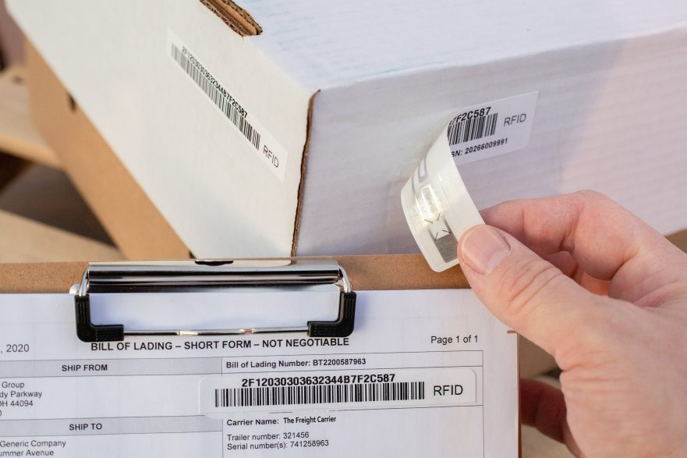
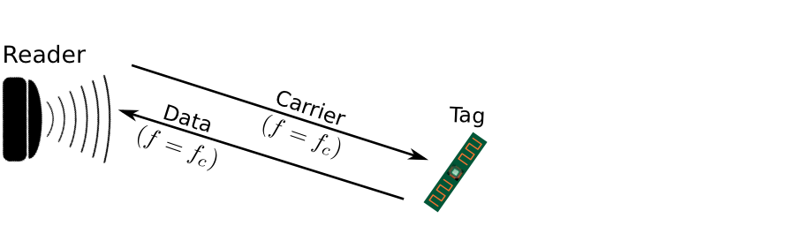
Enabling Sustainable, Large-scale Internet of Things
Internet of Things devices that can operate without batteries!
Breakthroughs to enable zero-power sensing and communication
Sensing and communication operations performed at microwatts of power
100-10,000X lower than state-of-the-art and commercial systems
RFID System
Notes:
++ We may all have heard of the term Internet of Things. So how are these wireless embedded systems related to the Internet of Things: Today, IoT includes a broad class of devices, including powerful platforms such as smartphones. However, it also includes more resource-constrained devices and what we call Wireless Embedded Systems, and in fact, I consider it to be one of the essential parts of the IoT ecosystem.
++ These are platforms equipped with a radio transceiver, sensor, microcontroller, and some form of energy storage. These platforms also often form a network, and sensor network as it is called has been an active area of research for the past two decades.
++ The research community has also developed wireless embedded platforms which we may know about, and these include: CMUCAM, which is an image sensor platform developed at Carnegie Mellon University, or Permamote is long life sensor platform from the lab I am associated with at UC Berkeley or Lorea which is a long-range backscatter platform that I had developed as part of my doctoral dissertation at Uppsala University. All of these are an example of Wireless Embedded Systems.

Slide 8
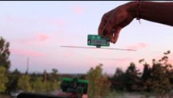
Reflecting Television Signals for Transmissions
Courtesy: University of Washington, Seattle
Ambient Backscatter: Wireless Communication Out of Thin Air, ACM SIGCOMM 2013

Slide 9
Long-range Backscatter Transmissions using LoRea
LoRea is a long range, low-power, and low-cost backscatter architecture
System Overview
Backscatter Tag Hardware Prototype
(Peak Power of 70 µW)
Varshney et al. ”LoRea: A Backscatter architecture that achieves a long communication range” ACM SENSYS 2017
Notes:
+ Over the past several years, I have designed systems that overcome these critical limitations that have hindered the backscatter systems and have the prevented widespread adoption of the backscatter mechanisms on the Internet of Things devices. One of these systems is LoRea.
+ LoRea was presented at ACM SENSYS, which is a flagship conference in the area of embedded sensor systems. I show the architecture of LoRea on the left-hand figure on the slide. It consists of one or more commodity devices such as a smartphone or Wi-Fi router that provides the necessary carrier signal to support backscatter transmissions, a low-power backscatter tag that I had designed and transmit at a peak power of 70uw, and one or more receiver of backscatter transmissions.
+ The key highlight of LoRea was that it could achieve a significantly larger communication range than existing systems, was designed using off the shelf components and cost (few tens of USDs). Further, the backscatter tag could achieve this capability at orders of magnitude lower energy than commercially available radio transceivers.
+ How did LoRea achieve this capability? We would describe next.

Slide 10
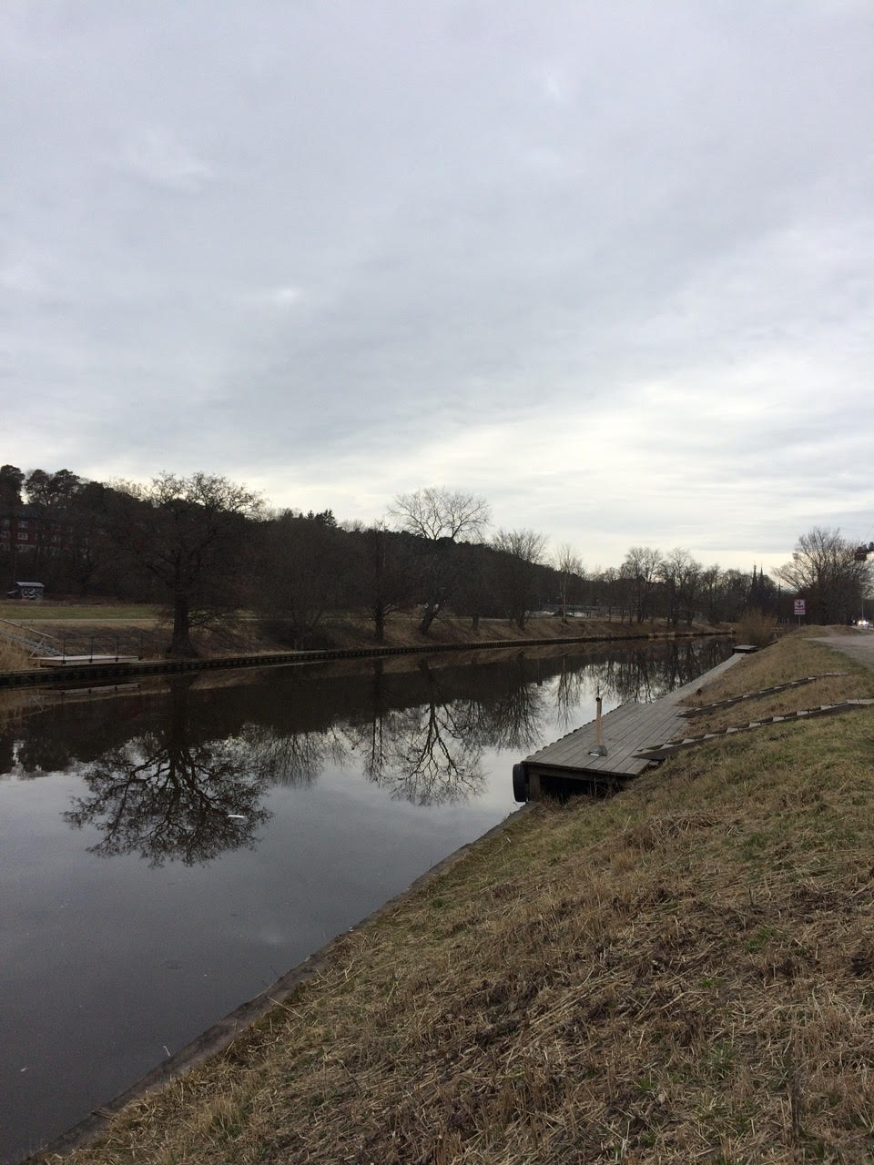
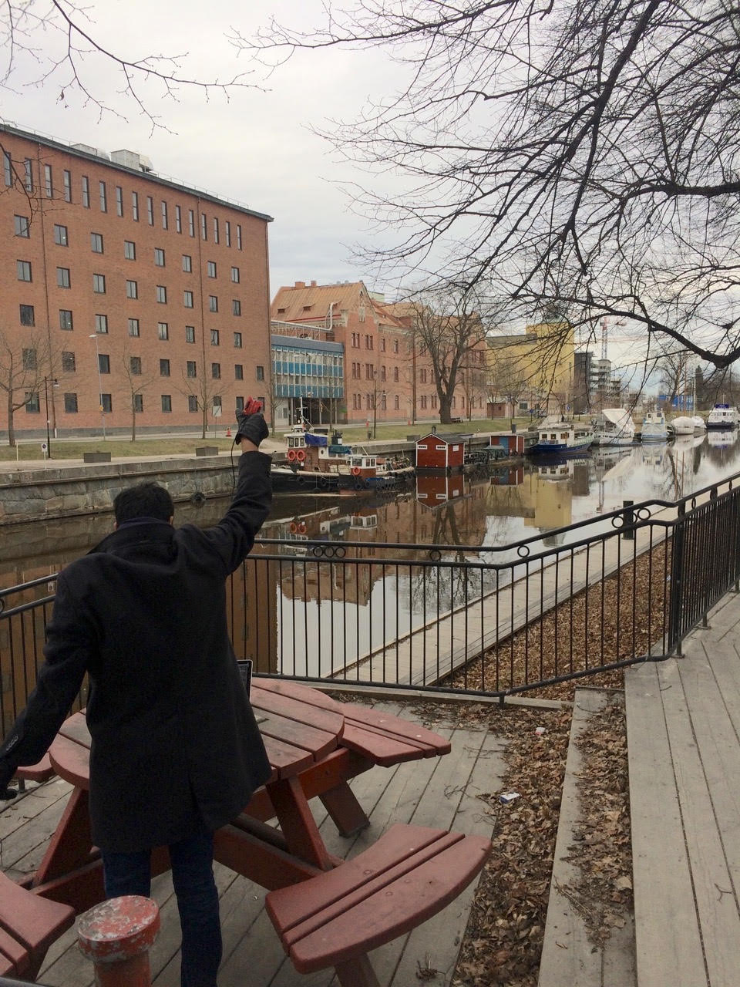
We ran out of space while performing experiments
State-of-art few meters. We achieved kilometers, was difficult to anticipate
Initial experiments conducted near the university and a river in Uppsala
Experiment Setup
Receiving transmissions 1km away from the setup
Notes:
Incorporating these three design elements, allows us to significantly push the communication range of the system. Next, we did experiments to investigate the transmission range that we can support with our system.
Performing these experiments was challenging as when we were designing LoRea the state of the art backscatter systems achieved a communication range of tens of meters. Hence, it was difficult to anticipate space required to perform these experiments.
We conducted the first experiment in the university, and we ran out the space, next we took the experiment setup next to a river in Uppsala. I show the setup on left hand side image, and on the right is picture of me capturing transmissions one kilometer away. However, while we were able to receive transmissions at fairly high SNR, we again ran out of space due to large range that we could achieve.

Slide 11
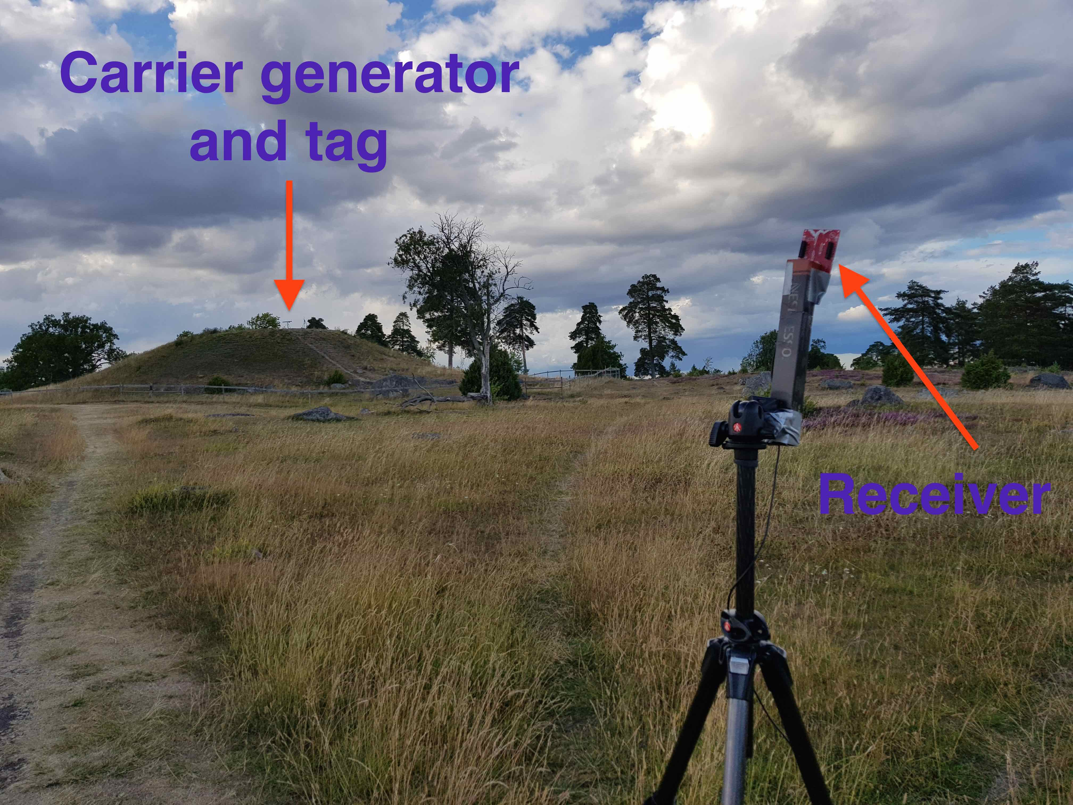
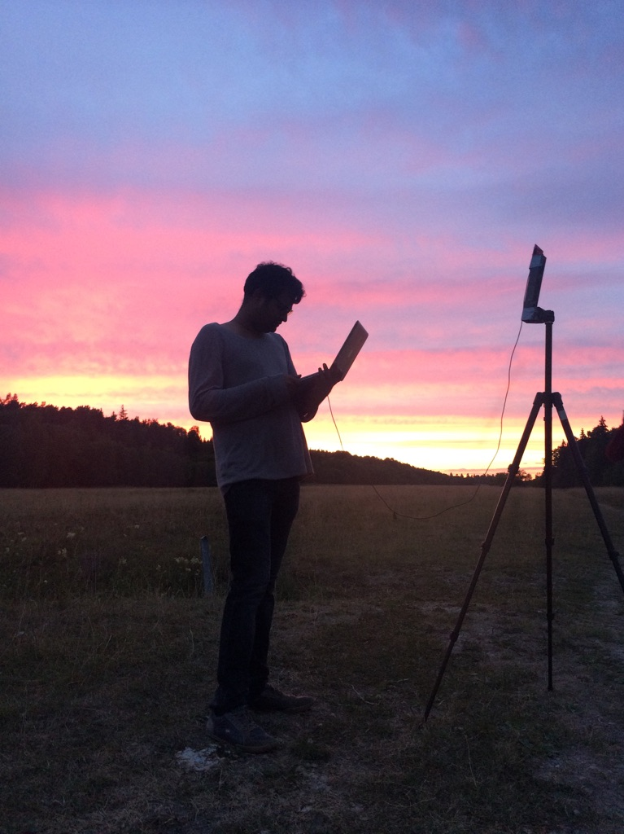
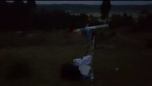
LoRea achieved the highest demonstrated range
Receive up to a distance of 3.4 kilometers from tag
Highest demonstrated range. Outperforms leading labs/universities
Experiment Setup
(On a small hill)
Receiving backscatter transmissions kilometers away from setup
Experiment setup video
Notes:
Hence, to find the maximum range we could achieve with our system, we took the entire setup outside Uppsala to an open space. We kept the backscatter setup on top of a small hill, and investigated the maximum communication range that we could support.
Performing these experiments was significantly challenging, as we would setup experiment in the daytime, and by the time we would finish collecting the link metrics, it would be dawn. We also had to walk significant distances with equipment.
We found that we could communicate up to a distance of 3.4 km while consuming tens of microwatts of power for wireless transmissions at the backscatter tag. Achieving such high communication range was considered challenging or even infeasible with backscatter mechanism, and LoRea helped overturn notion that backscatter is a low range transmission mechanism.

Slide 12
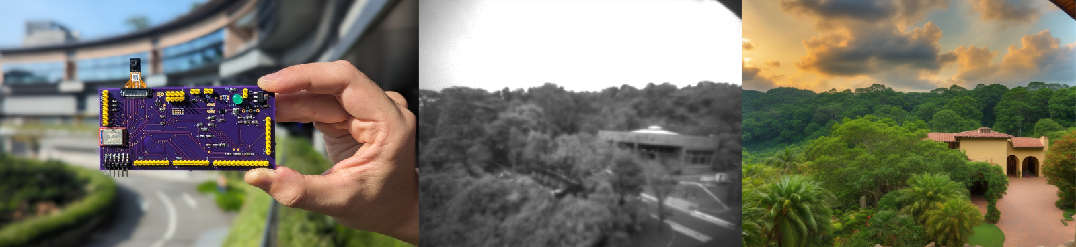
Rethinking Embedded Camera Systems
Intersection of Image/Language models with embedded systems
Low-power hardware, generate a rich representations of the world
Applications: Extended Reality! And many more!
Notes:
++ We may all have heard of the term Internet of Things. So how are these wireless embedded systems related to the Internet of Things: Today, IoT includes a broad class of devices, including powerful platforms such as smartphones. However, it also includes more resource-constrained devices and what we call Wireless Embedded Systems, and in fact, I consider it to be one of the essential parts of the IoT ecosystem.
++ These are platforms equipped with a radio transceiver, sensor, microcontroller, and some form of energy storage. These platforms also often form a network, and sensor network as it is called has been an active area of research for the past two decades.
++ The research community has also developed wireless embedded platforms which we may know about, and these include: CMUCAM, which is an image sensor platform developed at Carnegie Mellon University, or Permamote is long life sensor platform from the lab I am associated with at UC Berkeley or Lorea which is a long-range backscatter platform that I had developed as part of my doctoral dissertation at Uppsala University. All of these are an example of Wireless Embedded Systems.

Slide 13
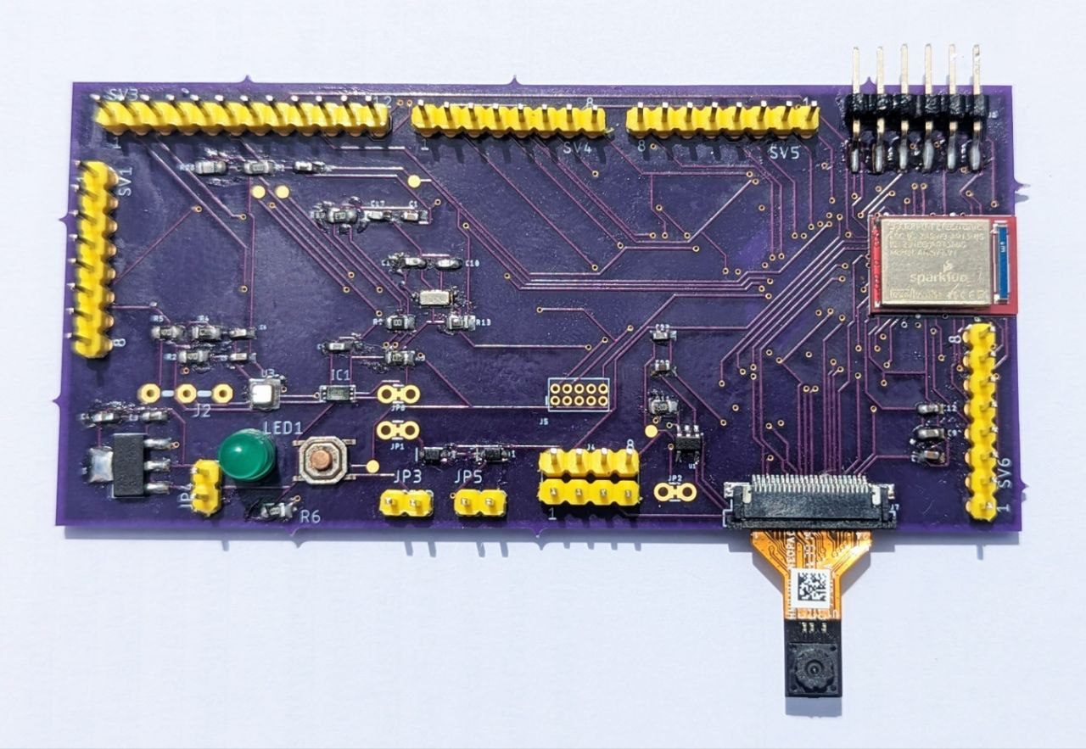
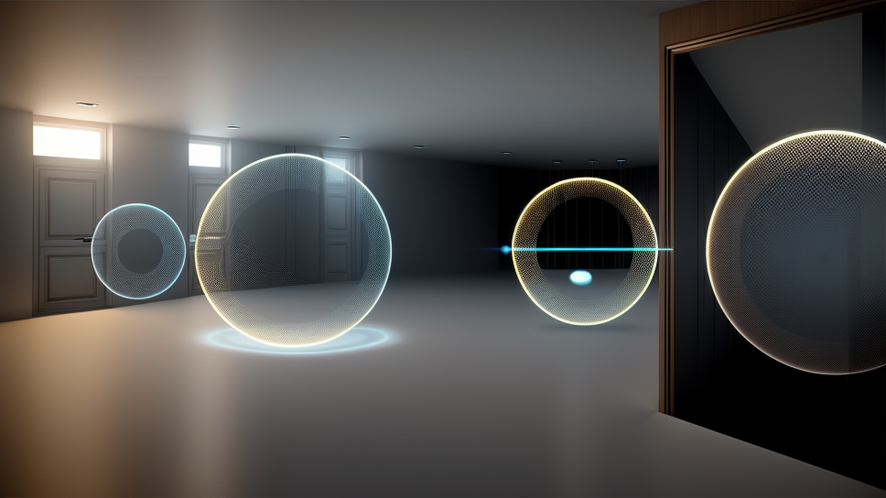
Rethinking Embedded Camera Systems
Intersection of Image/Language models with embedded systems
Low-power hardware, generate a rich representations of the world
Applications: Extended Reality! And many more!
Notes:
++ We may all have heard of the term Internet of Things. So how are these wireless embedded systems related to the Internet of Things: Today, IoT includes a broad class of devices, including powerful platforms such as smartphones. However, it also includes more resource-constrained devices and what we call Wireless Embedded Systems, and in fact, I consider it to be one of the essential parts of the IoT ecosystem.
++ These are platforms equipped with a radio transceiver, sensor, microcontroller, and some form of energy storage. These platforms also often form a network, and sensor network as it is called has been an active area of research for the past two decades.
++ The research community has also developed wireless embedded platforms which we may know about, and these include: CMUCAM, which is an image sensor platform developed at Carnegie Mellon University, or Permamote is long life sensor platform from the lab I am associated with at UC Berkeley or Lorea which is a long-range backscatter platform that I had developed as part of my doctoral dissertation at Uppsala University. All of these are an example of Wireless Embedded Systems.

Slide 14
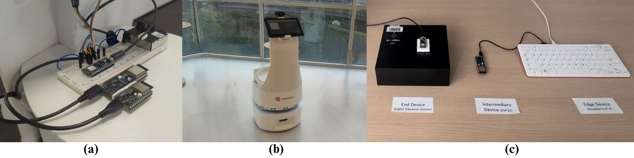
Controlling robots through voice and language models
Notes:
++ We may all have heard of the term Internet of Things. So how are these wireless embedded systems related to the Internet of Things: Today, IoT includes a broad class of devices, including powerful platforms such as smartphones. However, it also includes more resource-constrained devices and what we call Wireless Embedded Systems, and in fact, I consider it to be one of the essential parts of the IoT ecosystem.
++ These are platforms equipped with a radio transceiver, sensor, microcontroller, and some form of energy storage. These platforms also often form a network, and sensor network as it is called has been an active area of research for the past two decades.
++ The research community has also developed wireless embedded platforms which we may know about, and these include: CMUCAM, which is an image sensor platform developed at Carnegie Mellon University, or Permamote is long life sensor platform from the lab I am associated with at UC Berkeley or Lorea which is a long-range backscatter platform that I had developed as part of my doctoral dissertation at Uppsala University. All of these are an example of Wireless Embedded Systems.

Slide 15
You can work on projects like these during the course and also after with our group!
Notes:
++ Over the past few years, I have designed several backscatter and beyond backscatter systems that precisely overcome these critical challenges that have limited the widespread deployment of backscatter on IoT devices.
++ The research vision that I have pursued and would like to pursue as a faculty member is to enable a massive deployment of IoT devices by bridging the energy asymmetry between sensing, computation and communication blocks by designing novel platforms and communication mechanisms. I am going to describe some of my research contributions next.

Slide 16
Roadmap of the lecture today
Let us get to know the instructor ☺
What is this course about? Logistics? Grading Criteria?
Introduction to Embedded Systems, Rapid Growth
Mark Weiser Vision for Ubiquitous Computing
Understanding the Device Architecture and Scaling of Embedded Systems
Notes:
Here is the roadmap of the major topics that I am going to cover during the presentation. We have already covered the exponential growth of the internet of things; next, I will talk about the critical energy challenge that can severely hinder this massive growth and preventing us from realising this immense economic value enabled by the IoT.

Slide 17
Course Information
Notes:
++ Over the past few years, I have designed several backscatter and beyond backscatter systems that precisely overcome these critical challenges that have limited the widespread deployment of backscatter on IoT devices.
++ The research vision that I have pursued and would like to pursue as a faculty member is to enable a massive deployment of IoT devices by bridging the energy asymmetry between sensing, computation and communication blocks by designing novel platforms and communication mechanisms. I am going to describe some of my research contributions next.

Slide 18
General information regarding the course
Course code: CS 5272, Day of week: Monday, 6:30pm to 8:30pm
Plan for a lecture duration between 1-1.5 hours!
Office hours: COM3 - #2 – 25, Thursday : 4 – 6 pm (by appointment)
Please send me an email to reserve slot
What can you discuss? Anything related to course or wireless networking
Notes:
++ We may all have heard of the term Internet of Things. So how are these wireless embedded systems related to the Internet of Things: Today, IoT includes a broad class of devices, including powerful platforms such as smartphones. However, it also includes more resource-constrained devices and what we call Wireless Embedded Systems, and in fact, I consider it to be one of the essential parts of the IoT ecosystem.
++ These are platforms equipped with a radio transceiver, sensor, microcontroller, and some form of energy storage. These platforms also often form a network, and sensor network as it is called has been an active area of research for the past two decades.
++ The research community has also developed wireless embedded platforms which we may know about, and these include: CMUCAM, which is an image sensor platform developed at Carnegie Mellon University, or Permamote is long life sensor platform from the lab I am associated with at UC Berkeley or Lorea which is a long-range backscatter platform that I had developed as part of my doctoral dissertation at Uppsala University. All of these are an example of Wireless Embedded Systems.

Slide 19
Course webpage and other resources
There are no prescribed textbooks for the course
Lectures, reading of research paper, and learning through project
Course webpage: https://weiserlab.github.io/embeddefsoftware/
Provides a list of research papers and other course resources
Canvas will be used for the submission of term report, project
Notes:
++ We may all have heard of the term Internet of Things. So how are these wireless embedded systems related to the Internet of Things: Today, IoT includes a broad class of devices, including powerful platforms such as smartphones. However, it also includes more resource-constrained devices and what we call Wireless Embedded Systems, and in fact, I consider it to be one of the essential parts of the IoT ecosystem.
++ These are platforms equipped with a radio transceiver, sensor, microcontroller, and some form of energy storage. These platforms also often form a network, and sensor network as it is called has been an active area of research for the past two decades.
++ The research community has also developed wireless embedded platforms which we may know about, and these include: CMUCAM, which is an image sensor platform developed at Carnegie Mellon University, or Permamote is long life sensor platform from the lab I am associated with at UC Berkeley or Lorea which is a long-range backscatter platform that I had developed as part of my doctoral dissertation at Uppsala University. All of these are an example of Wireless Embedded Systems.

Slide 20
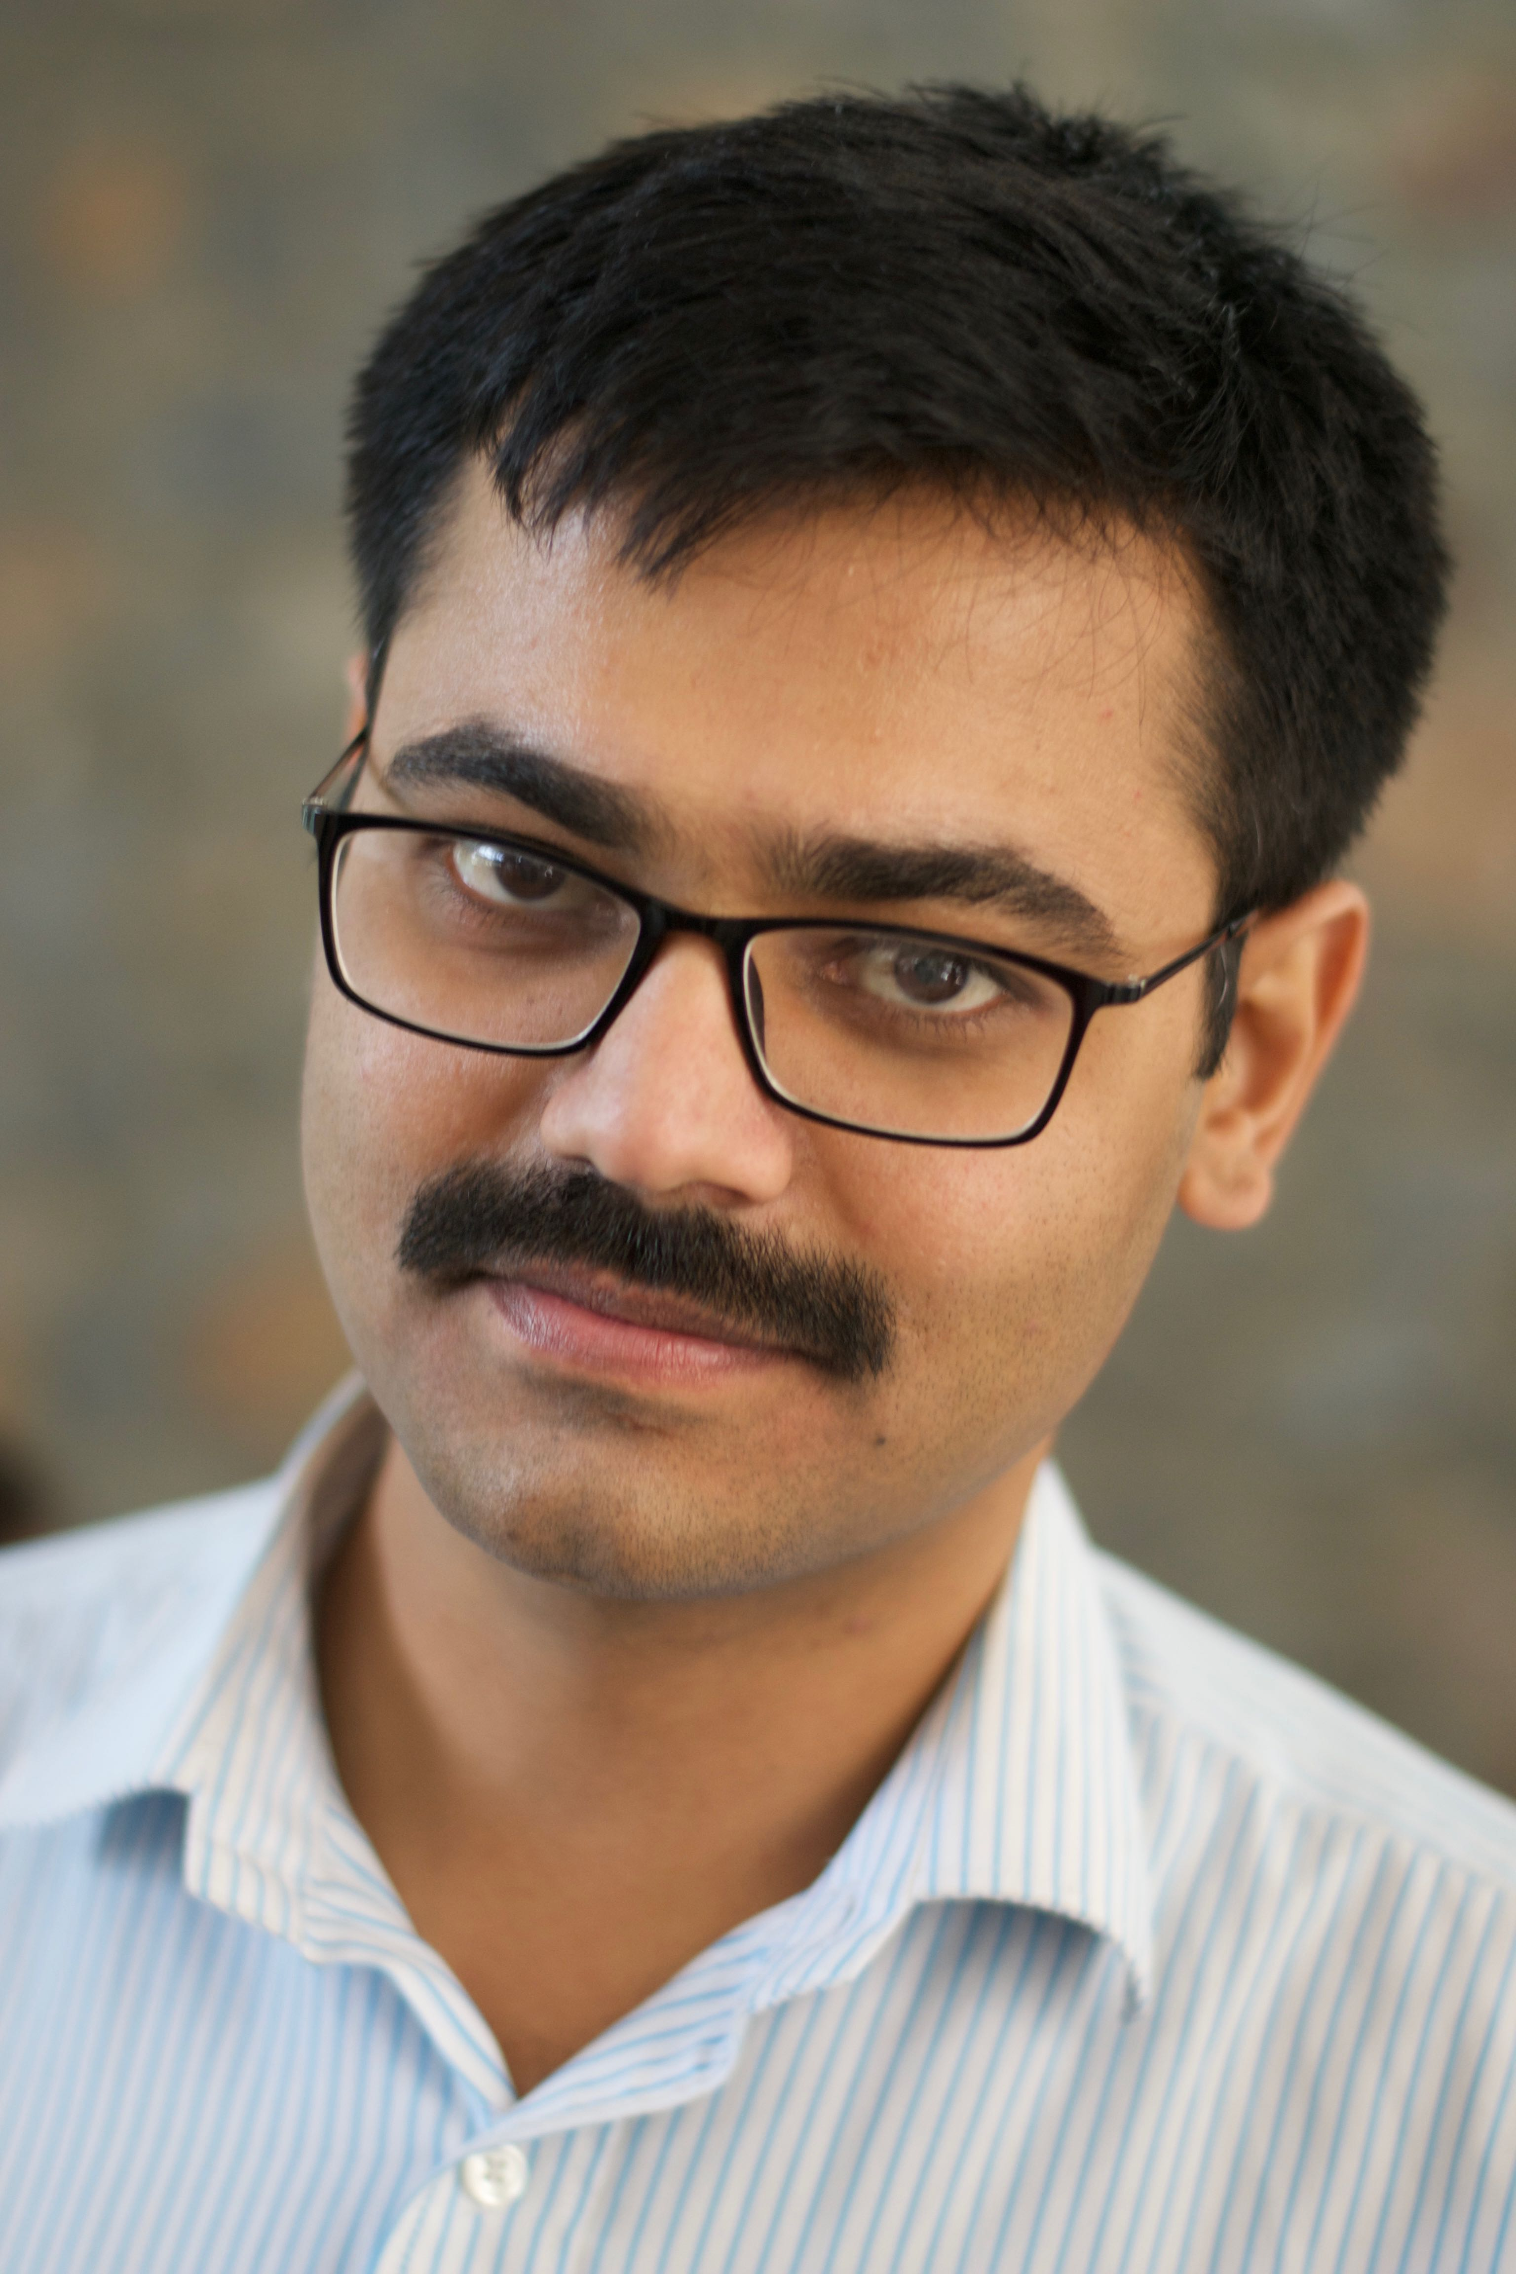
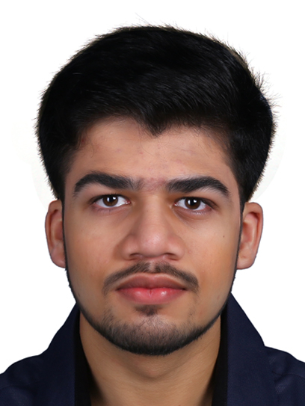
Support staff to help with the course
Dr. Manoj Gulati (Research Fellow)
Dhairya Jigar Shah (Research Assistant)
Notes:
++ We may all have heard of the term Internet of Things. So how are these wireless embedded systems related to the Internet of Things: Today, IoT includes a broad class of devices, including powerful platforms such as smartphones. However, it also includes more resource-constrained devices and what we call Wireless Embedded Systems, and in fact, I consider it to be one of the essential parts of the IoT ecosystem.
++ These are platforms equipped with a radio transceiver, sensor, microcontroller, and some form of energy storage. These platforms also often form a network, and sensor network as it is called has been an active area of research for the past two decades.
++ The research community has also developed wireless embedded platforms which we may know about, and these include: CMUCAM, which is an image sensor platform developed at Carnegie Mellon University, or Permamote is long life sensor platform from the lab I am associated with at UC Berkeley or Lorea which is a long-range backscatter platform that I had developed as part of my doctoral dissertation at Uppsala University. All of these are an example of Wireless Embedded Systems.

Slide 21
What is this course all about?
Notes:
++ Over the past few years, I have designed several backscatter and beyond backscatter systems that precisely overcome these critical challenges that have limited the widespread deployment of backscatter on IoT devices.
++ The research vision that I have pursued and would like to pursue as a faculty member is to enable a massive deployment of IoT devices by bridging the energy asymmetry between sensing, computation and communication blocks by designing novel platforms and communication mechanisms. I am going to describe some of my research contributions next.

Slide 22
CS5272: What is this course about?
This course introduces the fundamental principles of embedded systems with an emphasis on embedded device architecture and programming. A key emphasis of the course is wireless networking in the context of embedded systems. Additionally, the course also delves into sustainable or 'green' computing, discussing topics such as battery-free sensing and communication. The course also provides an overview of implementing machine learning (TinyML) and language and image models on embedded systems and edge devices, which is further explored in depth through student run class seminars and projects.
Notes:
Why do the IoT platforms suffer from this energy challenge? To understand this, we investigate the architecture of the IoT device. We show this architecture in the figure on the slide. It consists of a series of stages that enable us to sense physical phenomena, process and transmit the sensor information through a transceiver such as ZigBee/BLE/LoRa.
This architecture has remained unchanged over the past two decades. We find that during this time, sensors have become exceeding efficient. Today, we find sensors such as an accelerometer or a temperature sensor consumes just a few tens of microwatts of power consumption. However, we find that rest of the architecture components that are shown in red colour remain significantly energy expensive. To understand the reason for this significant energy asymmetry, we look at the following slide.

Slide 23
What are the different components of the course?
Lectures by the instructor
Readings provided during the course
Student class seminars (Individual)
Term paper (Individual)
Project (Can be done in a group)
End semester assessment (Likely removed in-favor of project)

Slide 24
How would the student’s performance be graded
Component | Weightage to Overall Grade
Project | 50 %
Student Seminar | 20 %
Term Paper | 30 %
If we decide to have final-assessment, the above percentage may change

Slide 25
Course Project
Enables students to learn programming embedded platforms by building an application. The expectation is that students will develop something substantial. It does not necessarily need to have research component
A number of platform available: ESP32, Raspberry Pi, MSP430, Backscatter, FPGAs, and many other. Talk to us! Reach out after lecture or office hours
Component | Weightage to Project
Problem Statement (Novelty) | 25 %
Project Report | 15 %
Presentation | 25 %
Execution | 35%

Slide 26
Term Paper
To write up to 4 page document describing the latest developments in a sub area of embedded systems. You can also describe the future developments and opportunities for research and development
Example: Machine learning on embedded systems, embedded camera, development in edge computing, health sensing ……
Conference venues: NSDI, MobiCom, Sigcomm, IMWUT, NSDI, SenSys
To be done individually. Grading at instructor discretion
Weightage to overall grade: 30%

Slide 27
Student Seminar
Student-led seminars are a critical component of the course, with attendance and active participation serving as key metrics for course evaluation. They require students to present a recent research paper (published within the last ten years) from prominent conferences in the field of embedded systems, such as ACM MobiSys, SenSys, MobiCom, Sigcomm, IMWUT, and NSDI.
Component | Weightage to Project
Attendance | 30 %
Presentation | 70 %

Slide 28
Potential topics for the student seminars
Research topics that could be of interest for discussion:
Classic sensor network and IoT deployments
Low-power, Long-range wireless networks [E.g. LoRa]
Wireless standards for IoT [ZigBee, BLE, WiFi]
Backscatter and energy harvesting
Other emerging wireless technologies for IoT [LiFi, Acoustic]
Security and operating systems for IoT
Novel applications
Others? Many more
We list them on the course webpage in coming weeks
Notes:
++ We may all have heard of the term Internet of Things. So how are these wireless embedded systems related to the Internet of Things: Today, IoT includes a broad class of devices, including powerful platforms such as smartphones. However, it also includes more resource-constrained devices and what we call Wireless Embedded Systems, and in fact, I consider it to be one of the essential parts of the IoT ecosystem.
++ These are platforms equipped with a radio transceiver, sensor, microcontroller, and some form of energy storage. These platforms also often form a network, and sensor network as it is called has been an active area of research for the past two decades.
++ The research community has also developed wireless embedded platforms which we may know about, and these include: CMUCAM, which is an image sensor platform developed at Carnegie Mellon University, or Permamote is long life sensor platform from the lab I am associated with at UC Berkeley or Lorea which is a long-range backscatter platform that I had developed as part of my doctoral dissertation at Uppsala University. All of these are an example of Wireless Embedded Systems.

Slide 29
Important Deadlines
Event | Date
Lectures | Starting Week 1 (15th January)
Student seminar paper selection | End of recess week (10th March)
Finalising project statement | End of recess week (10th March)
Student seminars | Lectures from 18th March
Project presentation | 15th April 2024
Term paper submission | 19th April 2024
Project submission | 19th April 2024

Slide 30
Break! Q&A (5 minutes)
Notes:
++ Over the past few years, I have designed several backscatter and beyond backscatter systems that precisely overcome these critical challenges that have limited the widespread deployment of backscatter on IoT devices.
++ The research vision that I have pursued and would like to pursue as a faculty member is to enable a massive deployment of IoT devices by bridging the energy asymmetry between sensing, computation and communication blocks by designing novel platforms and communication mechanisms. I am going to describe some of my research contributions next.

Slide 31
Let us Introduce Ourselves
Notes:
++ Over the past few years, I have designed several backscatter and beyond backscatter systems that precisely overcome these critical challenges that have limited the widespread deployment of backscatter on IoT devices.
++ The research vision that I have pursued and would like to pursue as a faculty member is to enable a massive deployment of IoT devices by bridging the energy asymmetry between sensing, computation and communication blocks by designing novel platforms and communication mechanisms. I am going to describe some of my research contributions next.

Slide 32
Roadmap of the lecture today
Let us get to know the instructor ☺
What is this course about? Logistics? Grading Criteria?
Introduction to Embedded Systems, Rapid Growth
Mark Weiser Vision for Ubiquitous Computing
Understanding the Device Architecture and Scaling of Embedded Systems
Notes:
Here is the roadmap of the major topics that I am going to cover during the presentation. We have already covered the exponential growth of the internet of things; next, I will talk about the critical energy challenge that can severely hinder this massive growth and preventing us from realising this immense economic value enabled by the IoT.

Slide 33
Do you know what the Internet of Things is? How does Internet of Things impact you?
Notes:
++ Over the past few years, I have designed several backscatter and beyond backscatter systems that precisely overcome these critical challenges that have limited the widespread deployment of backscatter on IoT devices.
++ The research vision that I have pursued and would like to pursue as a faculty member is to enable a massive deployment of IoT devices by bridging the energy asymmetry between sensing, computation and communication blocks by designing novel platforms and communication mechanisms. I am going to describe some of my research contributions next.

Slide 34
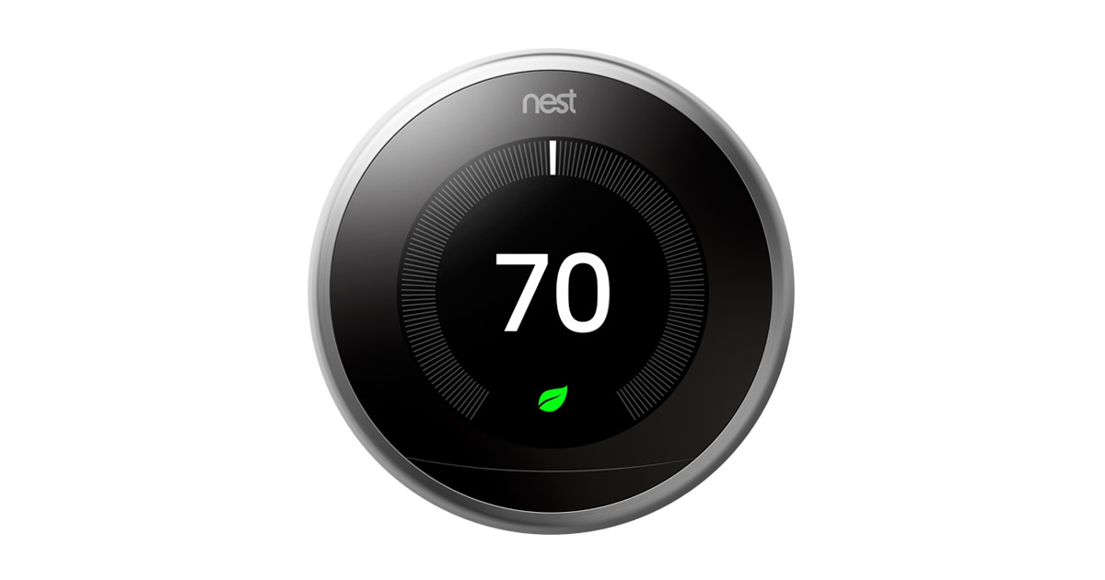
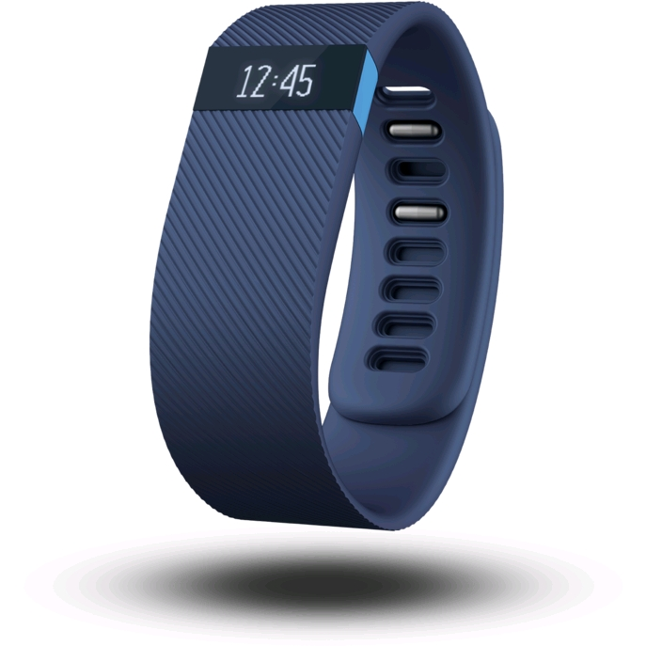
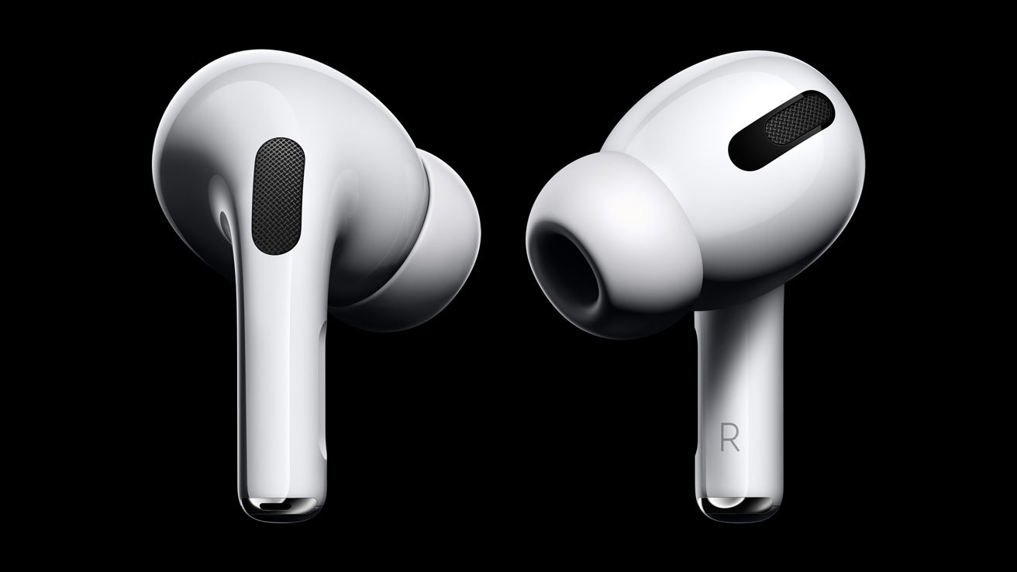
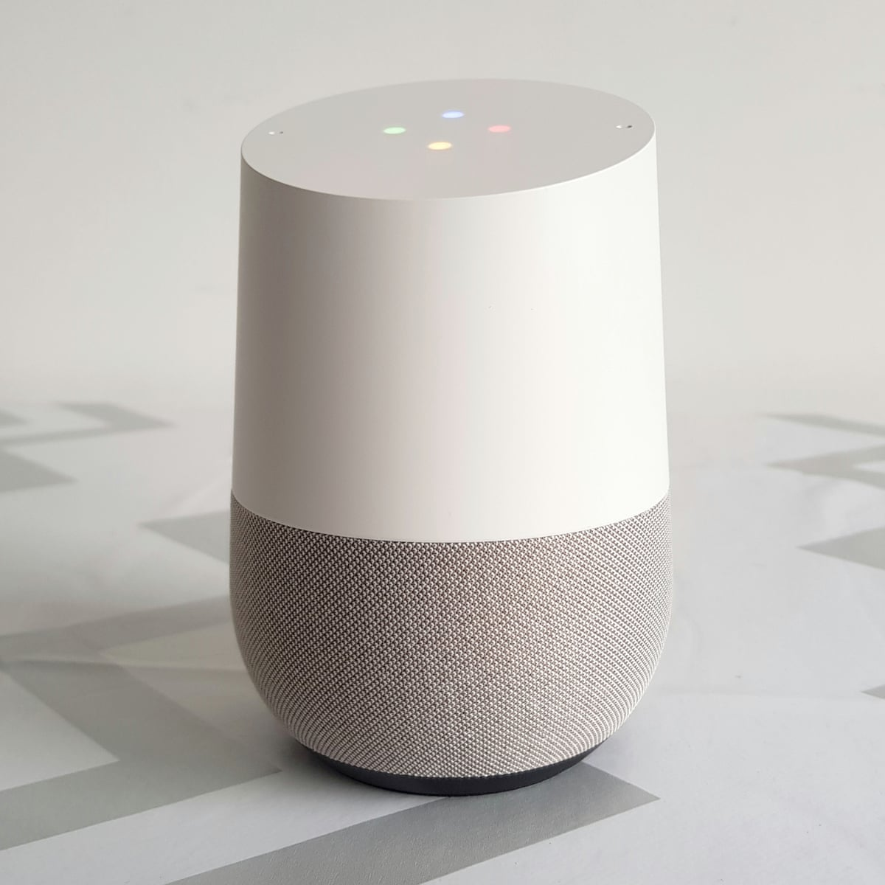
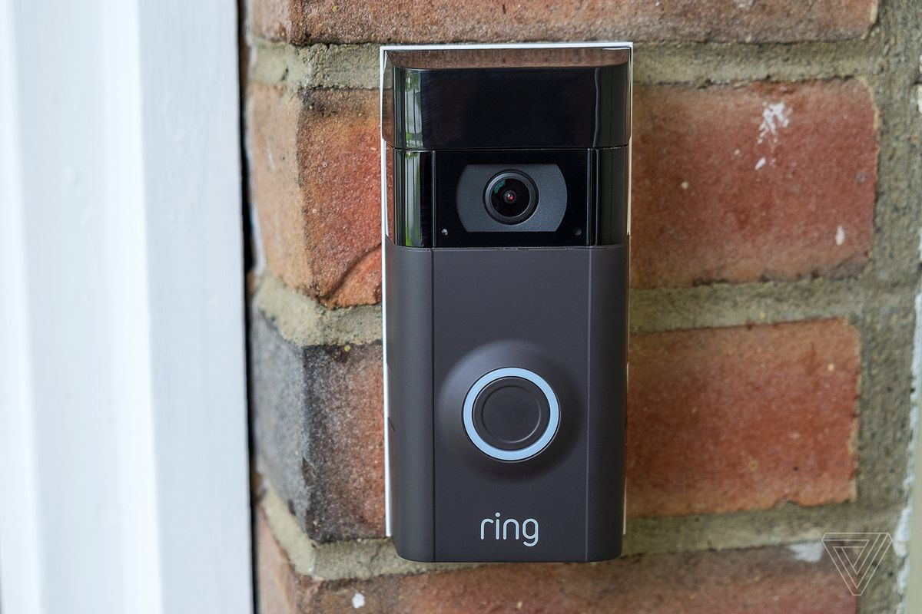
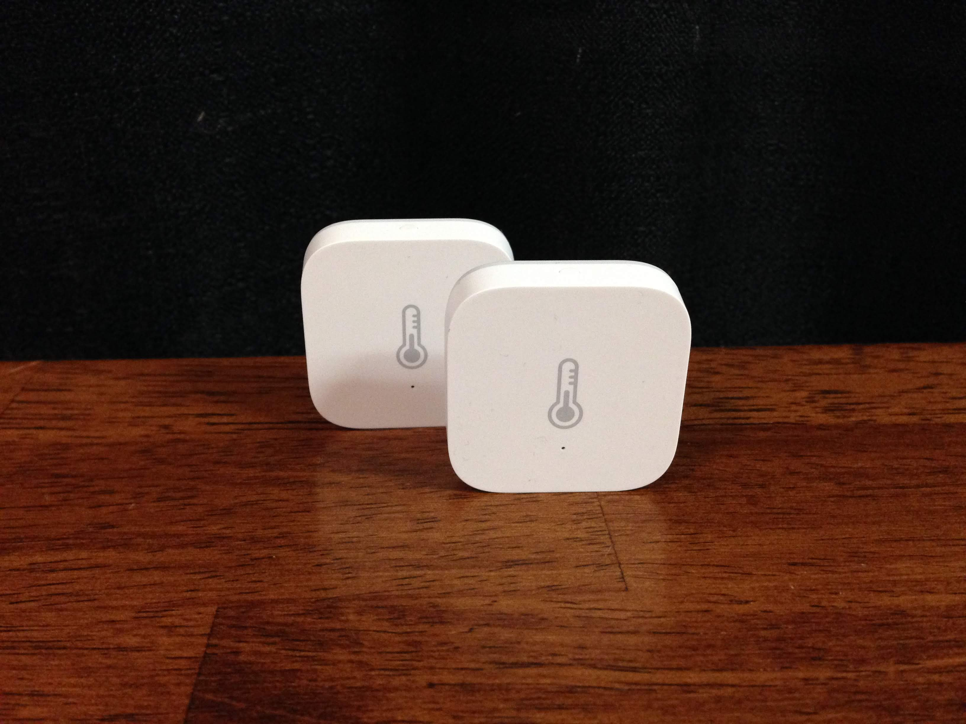
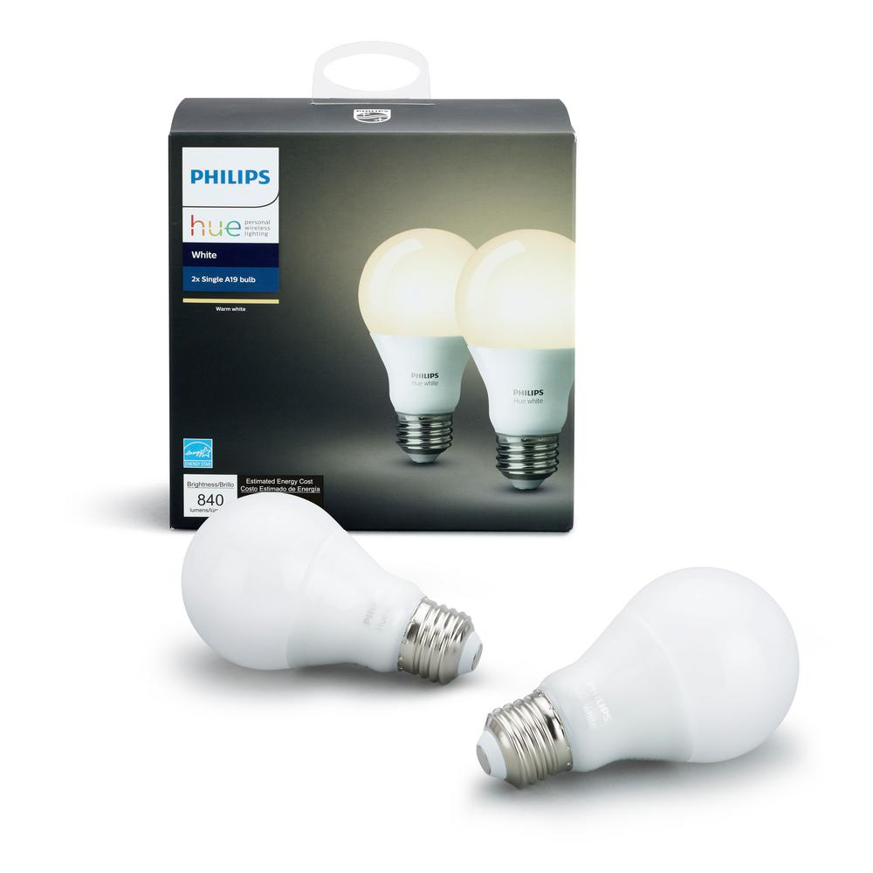
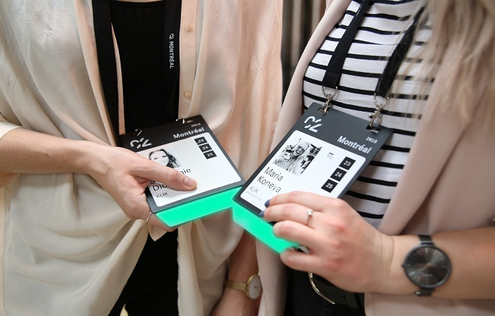
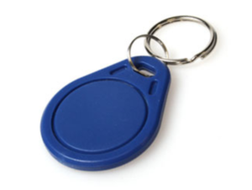
Internet of things devices are all around us...
Google nest thermostat
Fitbit activity tracker
Apple airpods
Smart speaker
Ring doorbell
Xiaomi temperature sensor
Philips hue smart bulb
Smart badges
BLE proximity beacon
Notes:
+ I begin this presentation by demonstrating devices that we interact with within our daily lives. These include Fitbit, AirPods, smart speakers or ble proximity beacons that we attach to objects such as keychain to keep track of them. All of these are examples of wireless embedded systems.

Slide 35
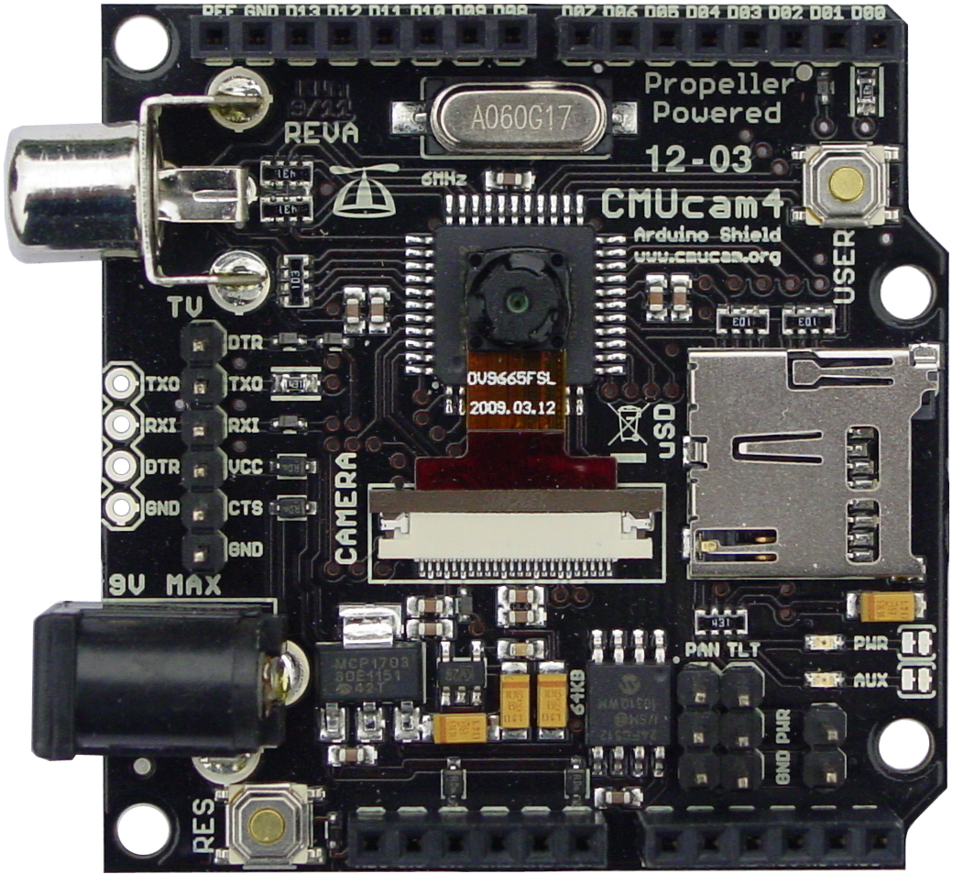
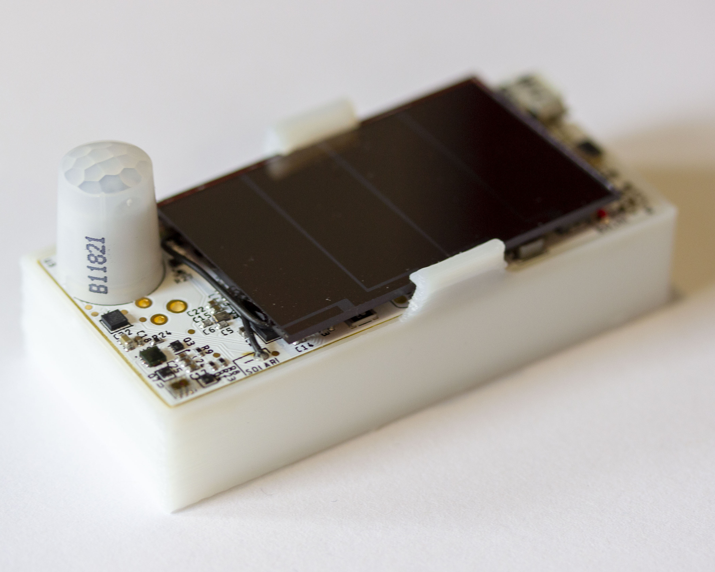
Internet of things and wireless embedded systems
Wireless embedded systems (WES) are platforms equipped with radio transceiver, sensors, microcontroller and some form of energy storage
WES are an important part of the internet of things (IoT) ecosystem
CMUCam
[Carnegie Mellon University]
Permamote
[University of California, Berkeley]
LoRea
[Uppsala University]
Notes:
++ We may all have heard of the term Internet of Things. So how are these wireless embedded systems related to the Internet of Things: Today, IoT includes a broad class of devices, including powerful platforms such as smartphones. However, it also includes more resource-constrained devices and what we call Wireless Embedded Systems, and in fact, I consider it to be one of the essential parts of the IoT ecosystem.
++ These are platforms equipped with a radio transceiver, sensor, microcontroller, and some form of energy storage. These platforms also often form a network, and sensor network as it is called has been an active area of research for the past two decades.
++ The research community has also developed wireless embedded platforms which we may know about, and these include: CMUCAM, which is an image sensor platform developed at Carnegie Mellon University, or Permamote is long life sensor platform from the lab I am associated with at UC Berkeley or Lorea which is a long-range backscatter platform that I had developed as part of my doctoral dissertation at Uppsala University. All of these are an example of Wireless Embedded Systems.

Slide 36
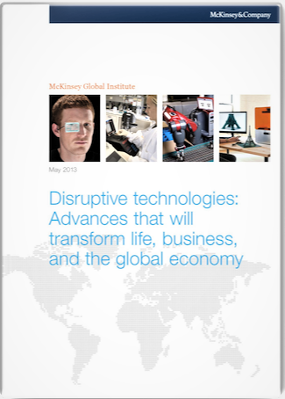
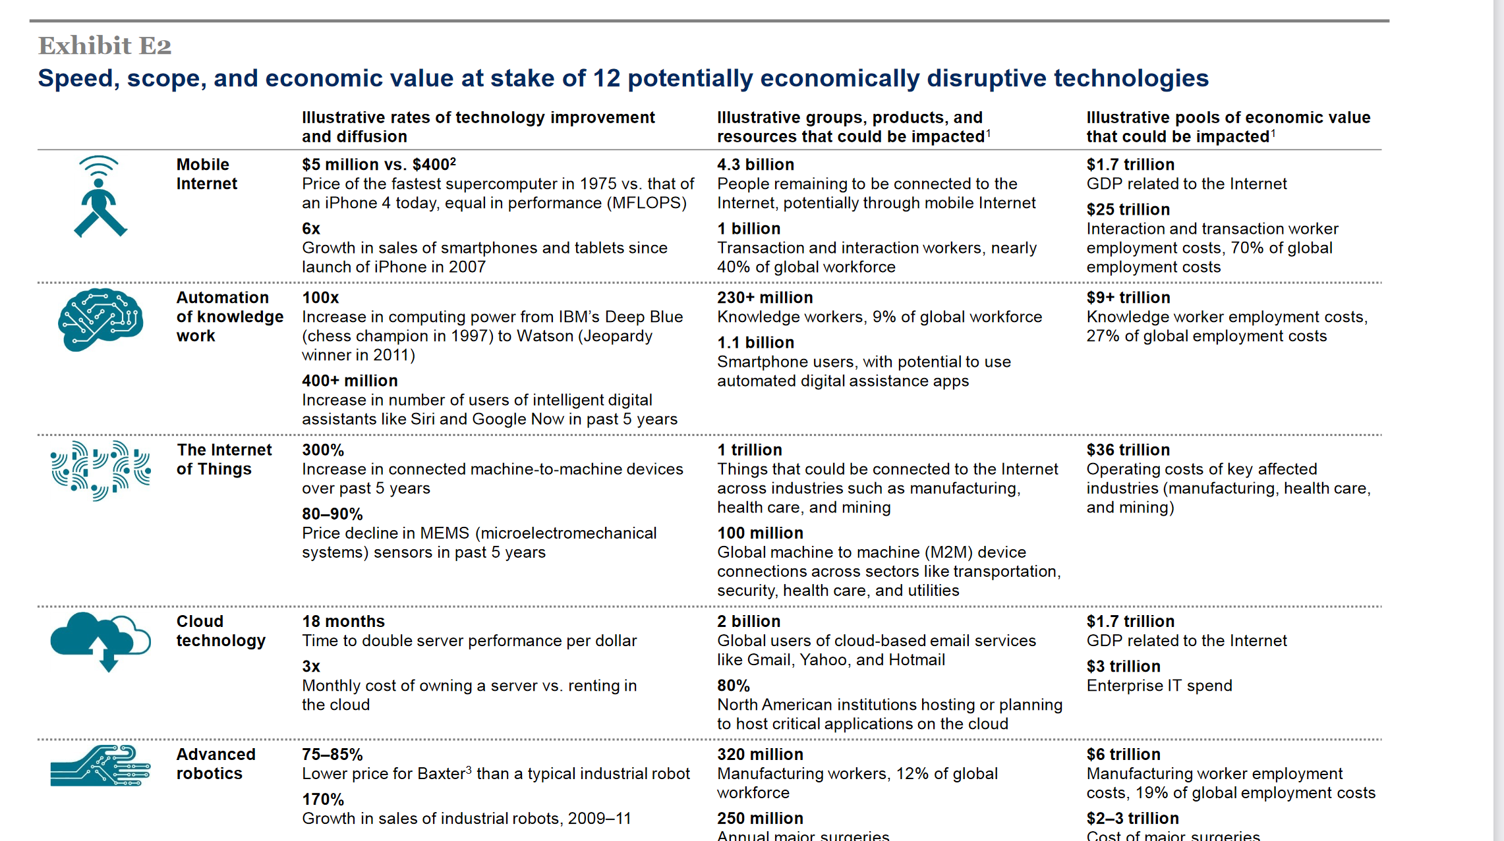
Internet of things will be bigger than cloud computing
Disruptive technologies: Advances that will transform life, business, and the global economy - McKinsey Global Institute (2013)
Notes:
So how big would the Internet of Things be?
We investigate a report from McKinsey called Disruptive Technologies which claims that the IoT would influence the combined economic value well over 36 trillion, far higher than cloud technology. Hence, this rapid growth in the IoT that we are witnessing is placing us on a pathway towards eclipsing (in economic value) major trends from previous decades, such as the cloud computing.

Slide 37
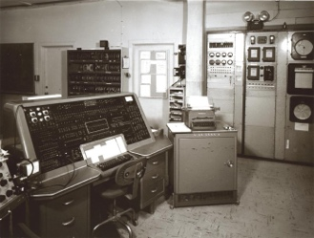
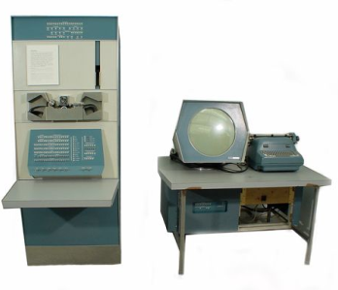
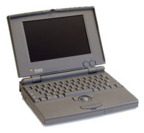
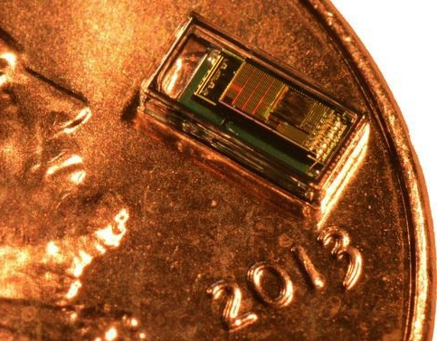
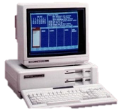

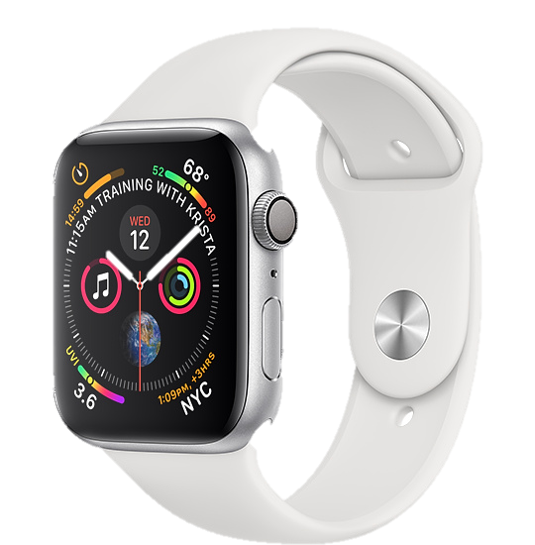
Trillion embedded devices will be deployed soon
Mainframe
“Roughly every decade a new, lower priced computer class forms based on a new programming platform, network, and interface resulting in new usage and the establishment of a new industry.”
1 per Enterprise
Workstation
1 per Engineer
[Bell et al. Computer, 1972, ACM, 2008]
Smart Dust
Laptop
100 – 1000’s per person
log (people per computer)
1 per Professional
IoT/Wearable
Mini Computer
10’s per person
1 per Company
Personal Computer
1 per Family
Smartphone
1 per person

Slide 38
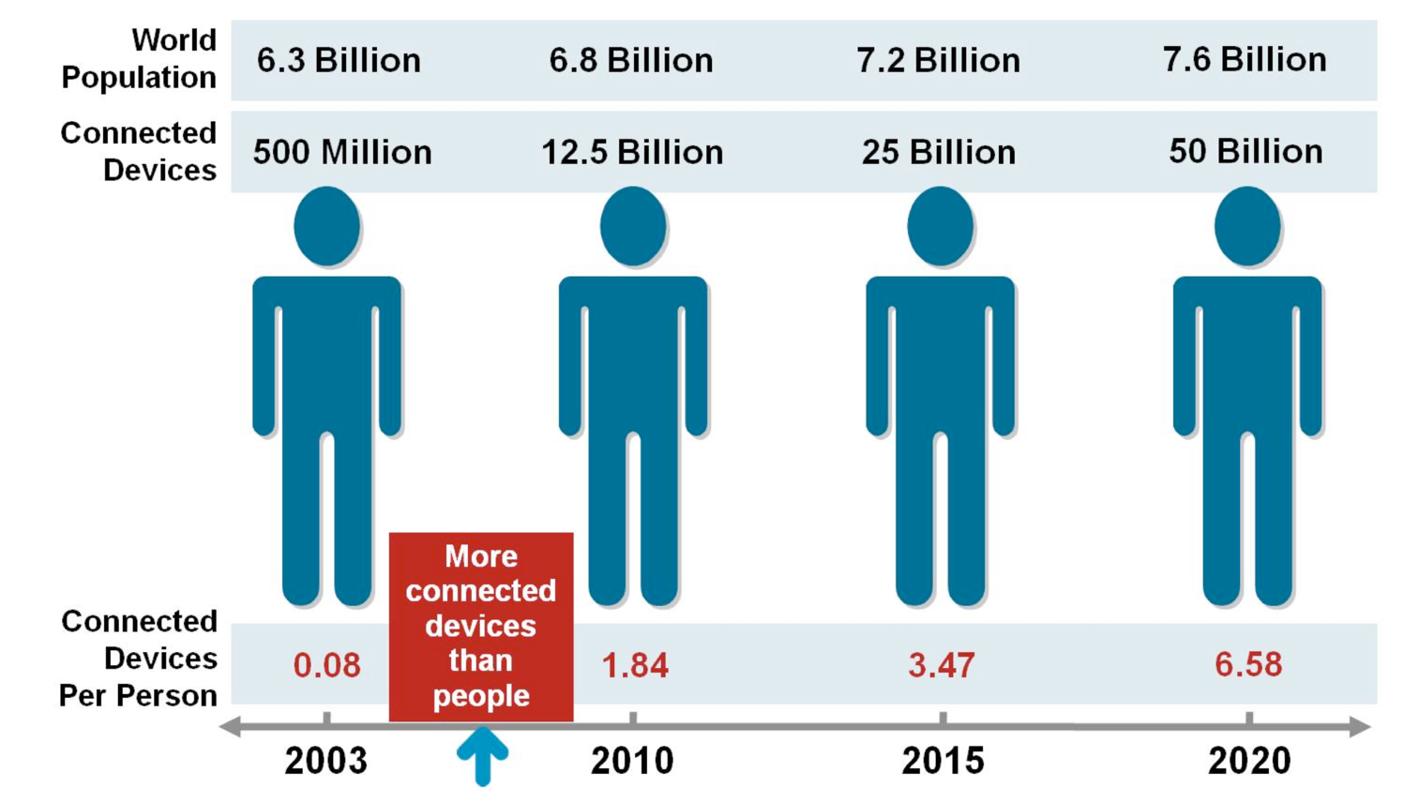
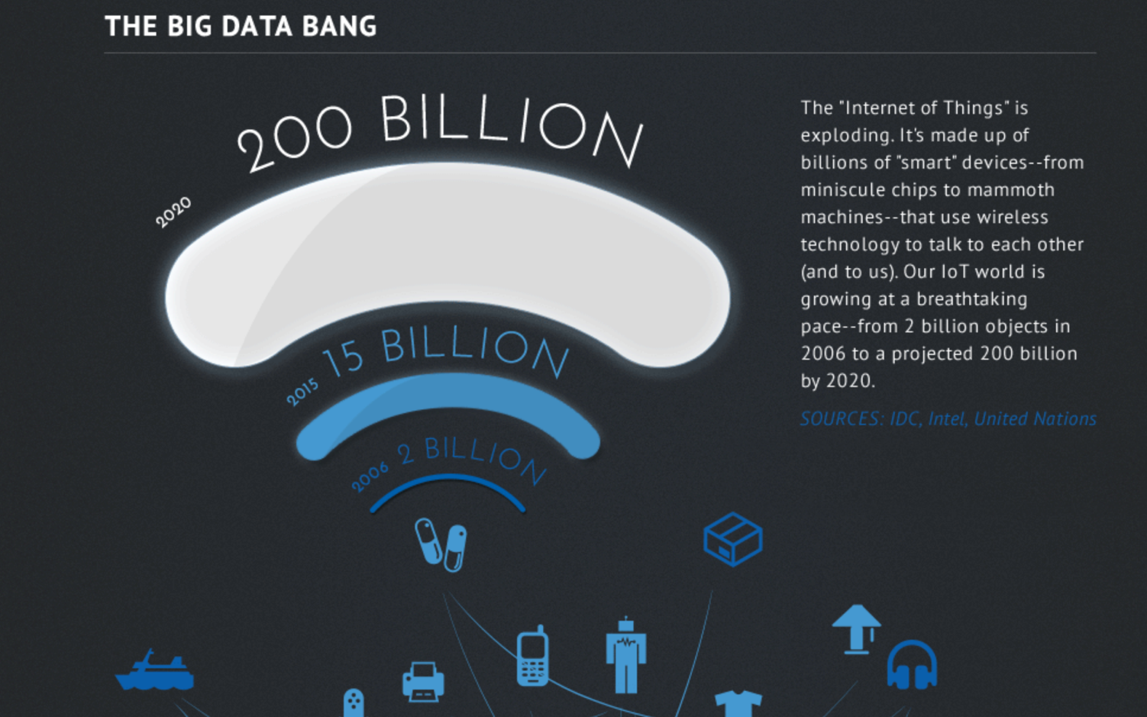
Let's go back to predictions about scale of IoT
Courtesy: CISCO
Courtesy: Intel
Notes:
So how big would the Internet of Things be?
We investigate a report from McKinsey called Disruptive Technologies which claims that the IoT would influence the combined economic value well over 36 trillion, far higher than cloud technology. Hence, this rapid growth in the IoT that we are witnessing is placing us on a pathway towards eclipsing (in economic value) major trends from previous decades, such as the cloud computing.

Slide 39
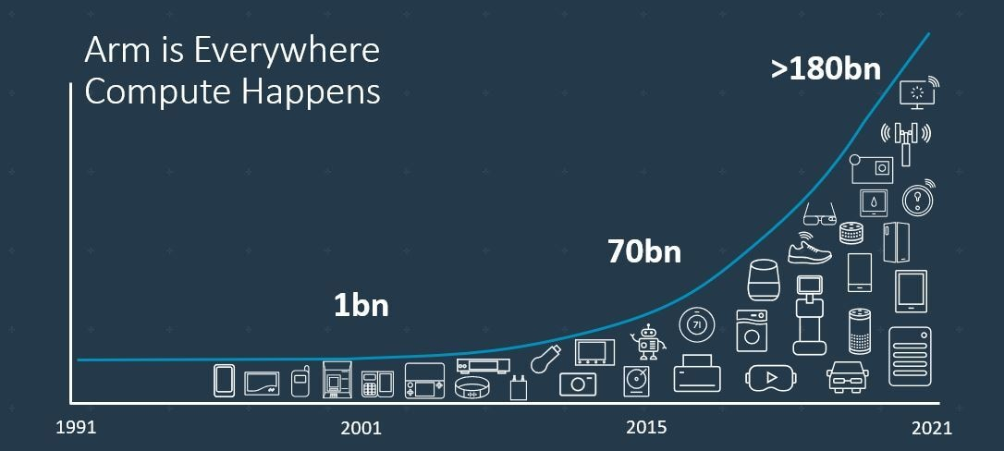
Trillion embedded devices will be deployed soon
Fourth quarter of 2020. Arm shipped 4.4 billion Cortex-M processors
ARM Press Release (Feb 11, 2021) reporting on Fourth Quarter 2020
Notes:
++ Due to the numerous applications that the internet of things enables, we are witnessing a massive growth in the number of microcontrollers being sold. These microcontrollers form the heart of the IoT platforms.
++ To illustrate this point: ARM, a popular UK based company, just reported numbers, and in these numbers, they state that they sold 4.4 billion cortex M processors in just one quarter. These microcontrollers are almost exclusively used on IoT platforms, which demonstrates the massive growth we are witnessing in the number of deployed IoT devices.
++ If this growth continues, and in fact, I believe this growth will accelerate, we will soon have a trillion embedded devices that are going to be deployed in the world.

Slide 40
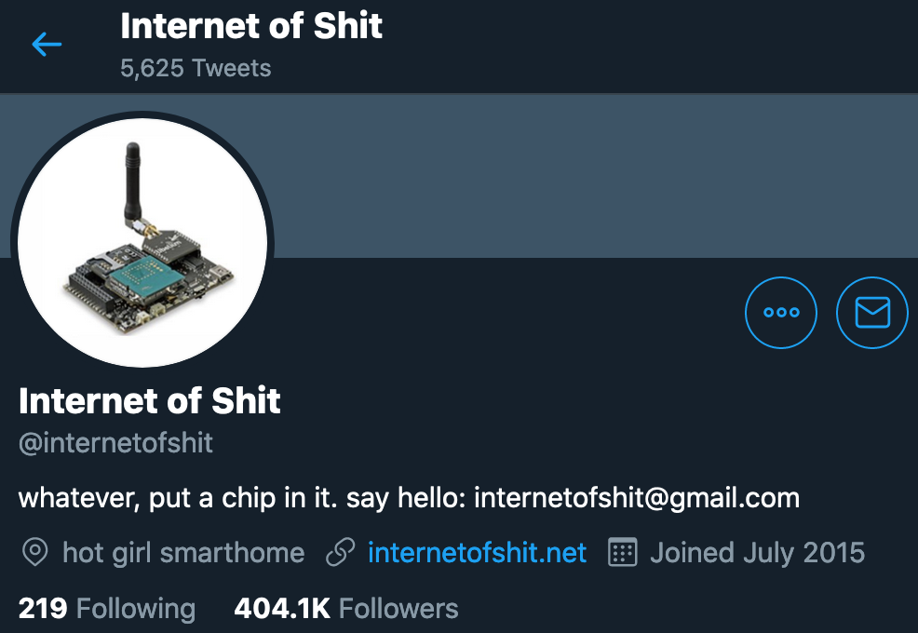
Word of caution: Mind the hype

Slide 41
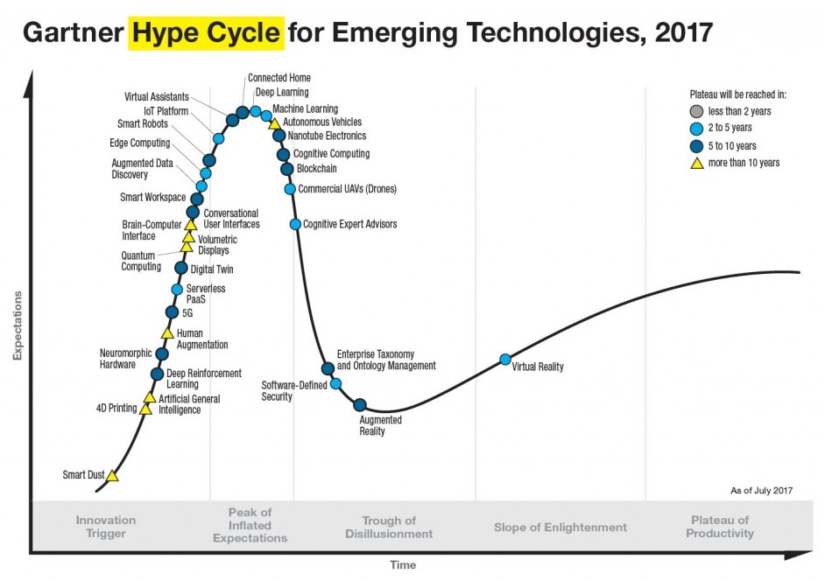
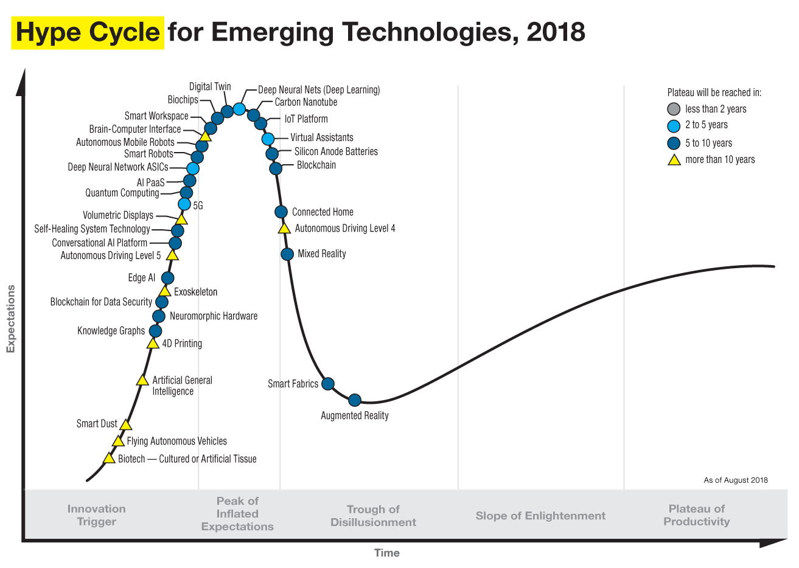
Word of caution: Mind the hype

Slide 42
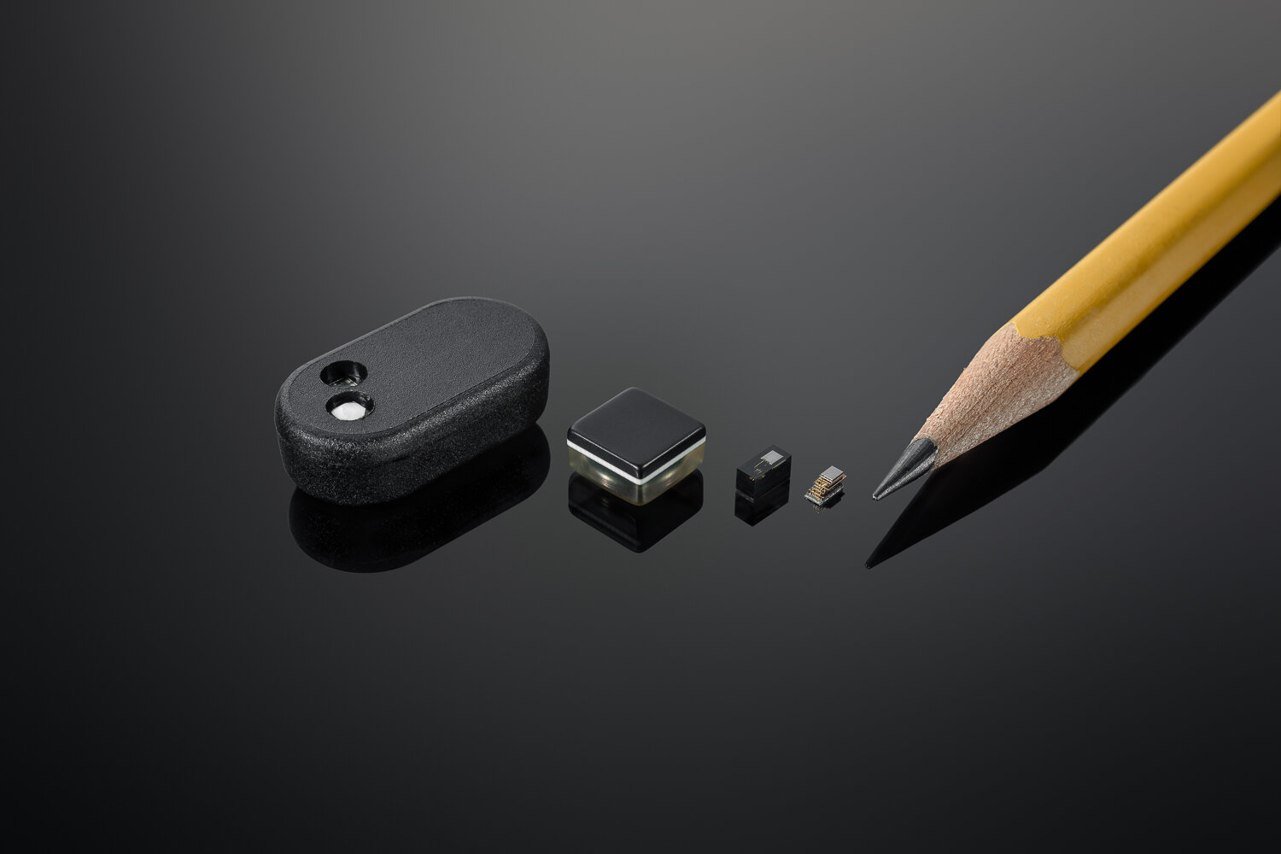
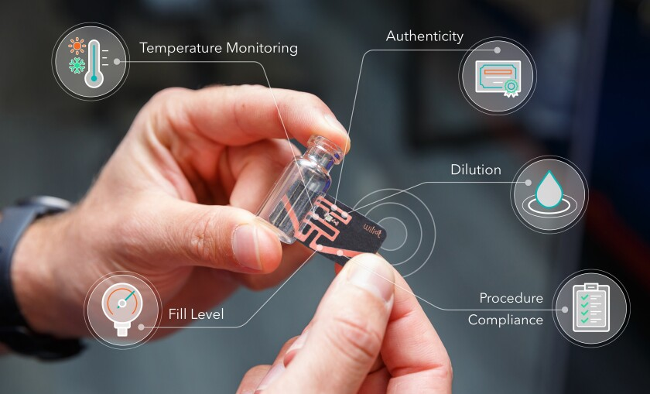
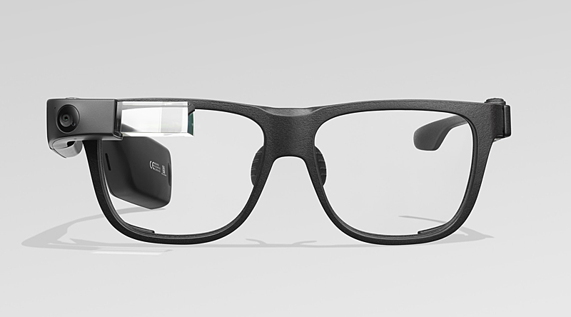
Where are we right now?

Slide 43

WilIoT: Battery-free, Bluetooth, Sticker form Sensors
Notes:
++ We may all have heard of the term Internet of Things. So how are these wireless embedded systems related to the Internet of Things: Today, IoT includes a broad class of devices, including powerful platforms such as smartphones. However, it also includes more resource-constrained devices and what we call Wireless Embedded Systems, and in fact, I consider it to be one of the essential parts of the IoT ecosystem.
++ These are platforms equipped with a radio transceiver, sensor, microcontroller, and some form of energy storage. These platforms also often form a network, and sensor network as it is called has been an active area of research for the past two decades.
++ The research community has also developed wireless embedded platforms which we may know about, and these include: CMUCAM, which is an image sensor platform developed at Carnegie Mellon University, or Permamote is long life sensor platform from the lab I am associated with at UC Berkeley or Lorea which is a long-range backscatter platform that I had developed as part of my doctoral dissertation at Uppsala University. All of these are an example of Wireless Embedded Systems.

Slide 44
Roadmap of the lecture today
Let us get to know the instructor ☺
What is this course about? Logistics? Grading Criteria?
Introduction to Embedded Systems, Rapid Growth
Mark Weiser Vision for Ubiquitous Computing
Understanding the Device Architecture and Scaling of Embedded Systems
Notes:
Here is the roadmap of the major topics that I am going to cover during the presentation. We have already covered the exponential growth of the internet of things; next, I will talk about the critical energy challenge that can severely hinder this massive growth and preventing us from realising this immense economic value enabled by the IoT.

Slide 45
Mark Weiser Vision for Ubiquitious Computing
Notes:
++ Over the past few years, I have designed several backscatter and beyond backscatter systems that precisely overcome these critical challenges that have limited the widespread deployment of backscatter on IoT devices.
++ The research vision that I have pursued and would like to pursue as a faculty member is to enable a massive deployment of IoT devices by bridging the energy asymmetry between sensing, computation and communication blocks by designing novel platforms and communication mechanisms. I am going to describe some of my research contributions next.

Slide 46

Mark Weiser vision of ubiquitous computing
Mark Weiser (1952 – 1999)
PhD (University of Michigan), CTO at Xerox PARC
Considered “Father” of ubiquitous computing
He is a highly influential figure in the area
What is ubiquitous computing?

Slide 47
Mark Weiser vision of ubiquitous computing
“Ubiquitous computing names the third wave in computing, just now beginning. First were mainframes, each shared by lots of people. Now we are in the personal computing era, person and machine staring uneasily at each other across the desktop. Next comes ubiquitous computing, or the age of calm technology, when technology recedes into the background of our lives.”

Slide 48
Mark Weiser vision of ubiquitous computing
“The most profound technologies are those that disappear”
”Products…that do not require active attention”
“Whenever people learn something sufficiently well, they cease to be aware of it”
“[Computers will become invisible and] people will simply use them unconsciously to accomplish everyday tasks”
“[R]ather than being a tool through which we work, and thus disappearing from our awareness, the computer too often remains the focus of attention”
“Applications are of course the whole point of ubiquitous computing”

Slide 49

Mark Weiser vision of ubiquitous computing
“The most profound technologies are those that disappear”
Do you agree? What are technologies we now take for granted?
Wearable devices (< 15 years), Smartphones, Smarthome sensors

Slide 50


Mark Weiser vision of ubiquitous computing
What are upcoming technologies that may become ubiquitous?

Slide 51

Mark Weiser vision of ubiquitous computing
The Computer for the 21st Century, Scientific American, 1991

Slide 52
Mark Weiser vision of ubiquitous computing
Hypothesis of the article: Advances in technology (low power, new wireless communication, new interfaces) will enable “invisible computing”, which will enhance human capability …

Slide 53
Roadmap of the lecture today
Let us get to know the instructor ☺
What is this course about? Logistics? Grading Criteria?
Introduction to Embedded Systems, Rapid Growth
Mark Weiser Vision for Ubiquitous Computing
Understanding the Device Architecture and Scaling of Embedded Systems
Notes:
Here is the roadmap of the major topics that I am going to cover during the presentation. We have already covered the exponential growth of the internet of things; next, I will talk about the critical energy challenge that can severely hinder this massive growth and preventing us from realising this immense economic value enabled by the IoT.

Slide 54
Device architecture of Wireless Embedded Systems
Notes:
++ Over the past few years, I have designed several backscatter and beyond backscatter systems that precisely overcome these critical challenges that have limited the widespread deployment of backscatter on IoT devices.
++ The research vision that I have pursued and would like to pursue as a faculty member is to enable a massive deployment of IoT devices by bridging the energy asymmetry between sensing, computation and communication blocks by designing novel platforms and communication mechanisms. I am going to describe some of my research contributions next.

Slide 55

Embedded systems covers number of CS/EEE areas

Slide 56









Four main tasks performed by an embedded device
Computation and Storage
Sensing and Actuation
Power
Management
Wireless Networking
Notes:
First, we look at the computational elements, and these consist of a microcontroller or an FPGA. Today, we find that these computational elements consume at least one order of magnitude higher power consumption when compared to the commonly used sensors.
However, we also find that microcontrollers are increasingly becoming energy efficient. We investigate a typical microcontroller that has been used in sensor platforms over the past two decades. We find that energy efficiency has improved by almost two orders of magnitude. Some of the present-generation microcontrollers, such as Ambiq Apollo4 consume just 3 uA/MHz than 330 uA for MSP430 used on platforms such as TelOS B.
If the trend continues, we can expect the microcontrollers to catch up with the sensors and become energy-efficient. This significant improvement is that the digital components are increasing becoming efficient as they follow moore’s law.

Slide 57

Wireless embedded devices architecture
During past decades, sensors have become exceedingly energy-efficient
E.g., Accelerometer, Temperature, Image Sensors: Few µW’s of power
Significant energy asymmetry exists between the sensors, computational elements and radio transceivers
Conventional and widely used architecture of embedded wireless platform
Notes:
Why do the IoT platforms suffer from this energy challenge? To understand this, we investigate the architecture of the IoT device. We show this architecture in the figure on the slide. It consists of a series of stages that enable us to sense physical phenomena, process and transmit the sensor information through a transceiver such as ZigBee/BLE/LoRa.
This architecture has remained unchanged over the past two decades. We find that during this time, sensors have become exceeding efficient. Today, we find sensors such as an accelerometer or a temperature sensor consumes just a few tens of microwatts of power consumption. However, we find that rest of the architecture components that are shown in red colour remain significantly energy expensive. To understand the reason for this significant energy asymmetry, we look at the following slide.

Slide 58


IC transistor count doubles every two years
Photo Credit: Intel
Notes:
So if we look at the computing spectrum today, each of the classes exist simultaneously. In a room we can put 100s of teraflops and many petabytes of computing.
Our productivity, document preparation, and personal information management fits in our pocket and a new class is emerging that will provide a means of streaming information to and from the physical world like we have never seen before.

Slide 59








MEMS Accelerometers: Rapidly falling price and power
O(mA)
Price
Power
25 µA @ 25 Hz
ADXL345
[Analog Devices, 2009]
10 µA @ 10 Hz @ 6 bits
[ST Microelectronics, annc. 2009]

Slide 60

Receiving LiFi at µW’s of power consumption
Avoid energy expensive components such as TIAs, ADCs
Solar cell (Photovoltaic mode) with a low-power comparator
LiFi Receiver Schematic
Solar cell response to LiFi transmissions
Enables us to receive LiFi transmissions at a power budget of 20 µW
Notes:
.

Slide 61

Demo: Battery-free Gesture Sensing and Recognition
Varshney et al. “Battery-free Visible Light Sensing” ACM VLCS 2017 (Best Paper)
ACM Mobicom 2017 SRC (Graduate winner)

Slide 62

Battery-free Cellphone
Courtesy: University of Washington, Seattle
Battery-free Cellphone, IMWUT/UBICOMP 2018

Slide 63


Computation is becoming energy inexpensive
Today, computation is at least an order of magnitude more energy expensive than performing a sensing operation
Digital components are becoming energy efficient (Moore’s law)
We can expect power consumption for computation to match sensing
Ambiq Apollo3
Notes:
First, we look at the computational elements, and these consist of a microcontroller or an FPGA. Today, we find that these computational elements consume at least one order of magnitude higher power consumption when compared to the commonly used sensors.
However, we also find that microcontrollers are increasingly becoming energy efficient. We investigate a typical microcontroller that has been used in sensor platforms over the past two decades. We find that energy efficiency has improved by almost two orders of magnitude. Some of the present-generation microcontrollers, such as Ambiq Apollo4 consume just 3 uA/MHz than 330 uA for MSP430 used on platforms such as TelOS B.
If the trend continues, we can expect the microcontrollers to catch up with the sensors and become energy-efficient. This significant improvement is that the digital components are increasing becoming efficient as they follow moore’s law.

Slide 64

Smart dust: Computers in the form of a dust
K. Pister, UC Berkeley, Smartdust

Slide 65

Communication remains a significant challenge
Performing communication remains orders of magnitude more energy expensive than performing sensing and computation
No scaling in power consumption due to Moore’s law. Energy expensive
Component | Power Consumption
Microcontroller (Apollo3) | 100s of µW’s (48 to 192 MHz)
Sensors | Few to tens of µW’s
Transceiver | Tens to Hundreds of mW’s
Power scaled with Moore’s law O(10 uW)
No such scaling O(100 mW)
Digital
(Baseband)
Analog
(RF)
Notes:
++ Due to the following of Moore’s law, we find that the microcontrollers are bridging the gap between sensing and computation. However, we find that communication remains a challenge and the most expensive IoT platforms' operation. Today the transceivers employed to perform communication consumes orders of magnitude higher energy when compared to performing sensing and processing operation.
++ Why are the communication blocks not witnessing such a dramatic decrease in power consumption? To understand this, we investigate the high-level diagram of the communication block. It consists of digital baseband generation circuitry and an analog front end. Due to the following of Moore’s law, digital baseband circuitry is becoming energy efficient. However, we do not witness any such scaling for the analog components. This causes these analog blocks to remain extremely energy expensive, pushing the power consumption for performing transmissions to be tens to hundreds of milliwatts. As an example, radio transceivers such as LoRa consume hundreds of milliwatts of power consumption. This is precisely the reason that present day IoT platforms operate with limited lifetime even on bulky and energy dense batteries.

Slide 66

Wireless embedded systems has an energy challenge
Devices that comprise wireless embedded systems are energy expensive:
Operate on bulky batteries. Frequent replacement. Challenging at scale
Challenging to realize novel form factor for the platform (sticker)
Energy challenge is biggest hindrance to unlocking trillions of dollars economic value enabled through the massive deployment of IoT devices
TelOS B Sensor node (Powered by AA batteries)
Flexible backscatter tag based on LoRea (SENSYS 2017)
Notes:
++ While we are deploying an enormously large number of IoT devices, I claim that very little attention is being paid to their energy challenge.
++ Today, most IoT devices are very energy expensive, and consequently, they rely on bulky batteries such as AA/AAA sized batteries for their operation. Even when operating on these batteries, they require frequent replacement of the exhausted batteries. This can be challenging when performed at a massive scale, especially considering that we may have a trillion embedded device deployed in the world.
++ Further, it can also harm the environment. These batteries use toxic chemicals, which means now we can have billions of toxic chemicals laden batteries that would be disposed of in landfills. This is especially important as sustainability has become an essential aspect across the world; in fact, imperial college was celebrating sustainability week.

Slide 67


Wireless embedded systems has an energy challenge
Notes:
++ While we are deploying an enormously large number of IoT devices, I claim that very little attention is being paid to their energy challenge.
++ Today, most IoT devices are very energy expensive, and consequently, they rely on bulky batteries such as AA/AAA sized batteries for their operation. Even when operating on these batteries, they require frequent replacement of the exhausted batteries. This can be challenging when performed at a massive scale, especially considering that we may have a trillion embedded device deployed in the world.
++ Further, it can also harm the environment. These batteries use toxic chemicals, which means now we can have billions of toxic chemicals laden batteries that would be disposed of in landfills. This is especially important as sustainability has become an essential aspect across the world; in fact, imperial college was celebrating sustainability week.

Slide 68
Why is the task of performing wireless communication energy expensive? How do we enable battery-free wireless devices that don’t harm the environment?
Notes:
++ Over the past few years, I have designed several backscatter and beyond backscatter systems that precisely overcome these critical challenges that have limited the widespread deployment of backscatter on IoT devices.
++ The research vision that I have pursued and would like to pursue as a faculty member is to enable a massive deployment of IoT devices by bridging the energy asymmetry between sensing, computation and communication blocks by designing novel platforms and communication mechanisms. I am going to describe some of my research contributions next.

Slide 69
Suggested reading and next steps
On the course page under reading section
“The computer for 21st Century, Scientific American, 1991”
Start thinking about who would you like to form group for the project
Topic for the project (ongoing process) and seminar paper (ongoing)
Notes:
++ We may all have heard of the term Internet of Things. So how are these wireless embedded systems related to the Internet of Things: Today, IoT includes a broad class of devices, including powerful platforms such as smartphones. However, it also includes more resource-constrained devices and what we call Wireless Embedded Systems, and in fact, I consider it to be one of the essential parts of the IoT ecosystem.
++ These are platforms equipped with a radio transceiver, sensor, microcontroller, and some form of energy storage. These platforms also often form a network, and sensor network as it is called has been an active area of research for the past two decades.
++ The research community has also developed wireless embedded platforms which we may know about, and these include: CMUCAM, which is an image sensor platform developed at Carnegie Mellon University, or Permamote is long life sensor platform from the lab I am associated with at UC Berkeley or Lorea which is a long-range backscatter platform that I had developed as part of my doctoral dissertation at Uppsala University. All of these are an example of Wireless Embedded Systems.

Slide 70
Roadmap of the lecture today
Let us get to know the instructor ☺
What is this course about? Logistics? Grading Criteria?
Introduction to Embedded Systems, Rapid Growth
Mark Weiser Vision for Ubiquitous Computing
Understanding the Device Architecture and Scaling of Embedded Systems
Notes:
Here is the roadmap of the major topics that I am going to cover during the presentation. We have already covered the exponential growth of the internet of things; next, I will talk about the critical energy challenge that can severely hinder this massive growth and preventing us from realising this immense economic value enabled by the IoT.

Slide 71
Embedded Software Programming
Ambuj Varshney
ambujv@nus.edu.sg
Notes:
++ Thank you for inviting me to give this talk
++ In this talk, I will present a pathway that can enable us to make wireless embedded systems ubiquitous. I will describe my previous research efforts that tackle the critical challenges that limit the growth of wireless embedded systems. These are related to the growing energy asymmetry that exists between sensing, computation and communication blocks on these platforms.
++ Finally, I will conclude my talk by covering the research agenda that I would like to work on as a faculty member.

